Slide 1
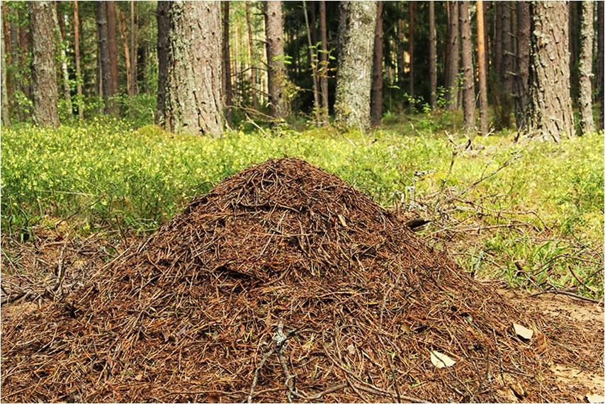
What we are going to talk about?

Slide 2
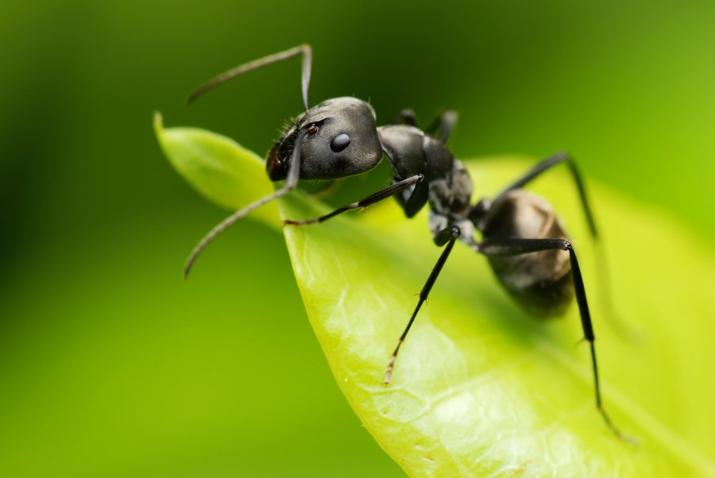
Ant

Slide 3

Anthill

Slide 4
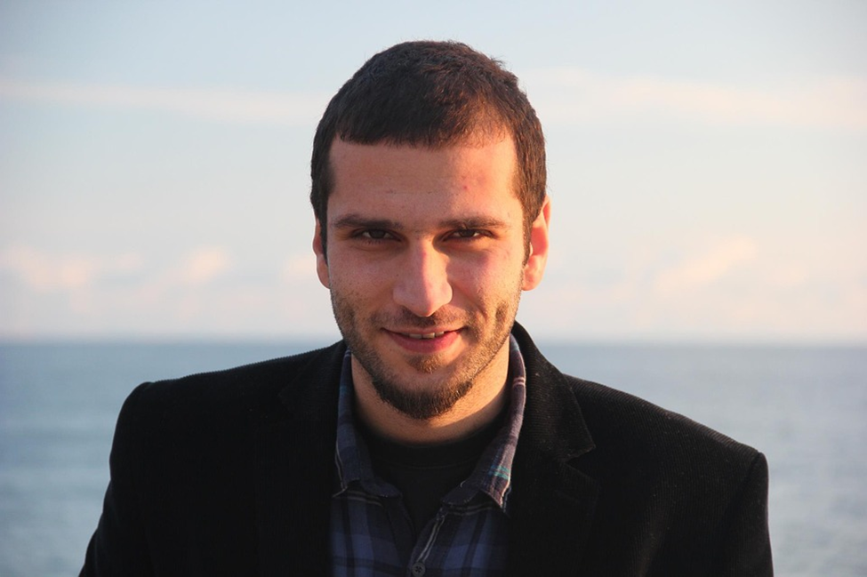
Man

Slide 5

Worker

Slide 6
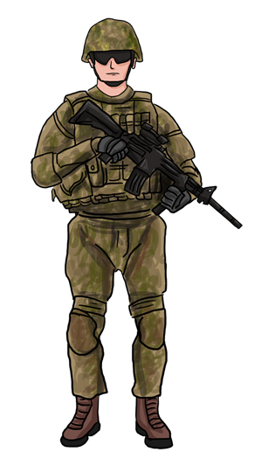
Soldier

Slide 7
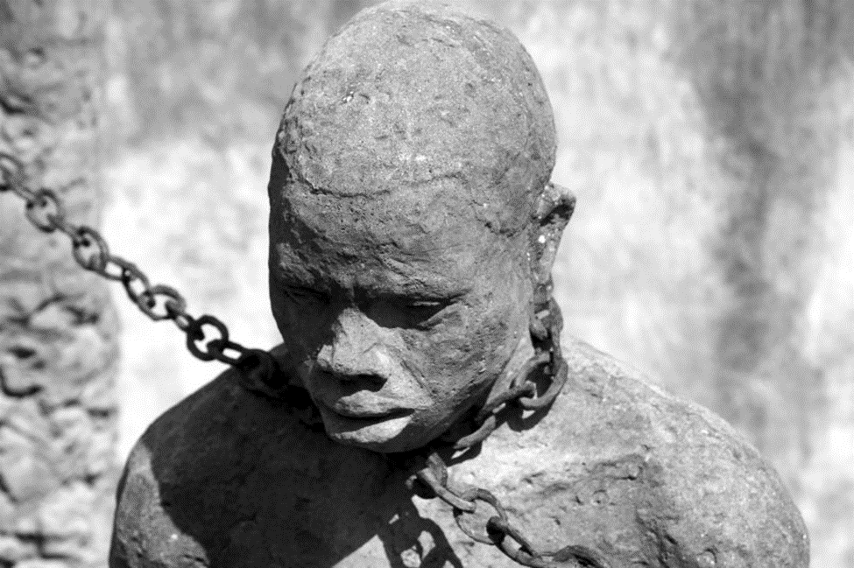
Slave

Slide 8

Own work

Slide 9
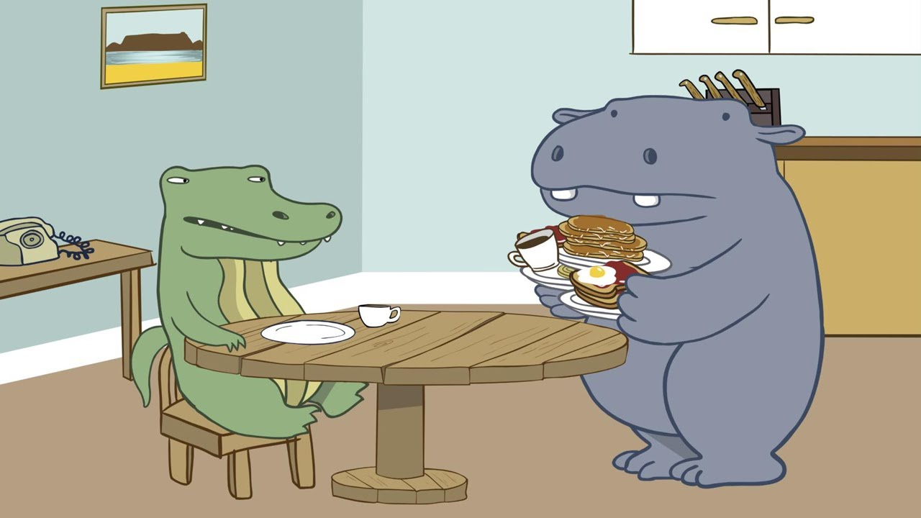
Like people in some ways

Slide 10
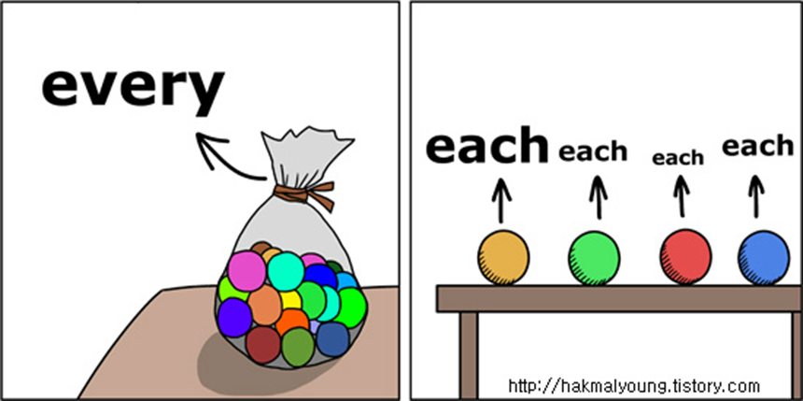
Each

Slide 11

Many kinds of work

Slide 12


Slide 13
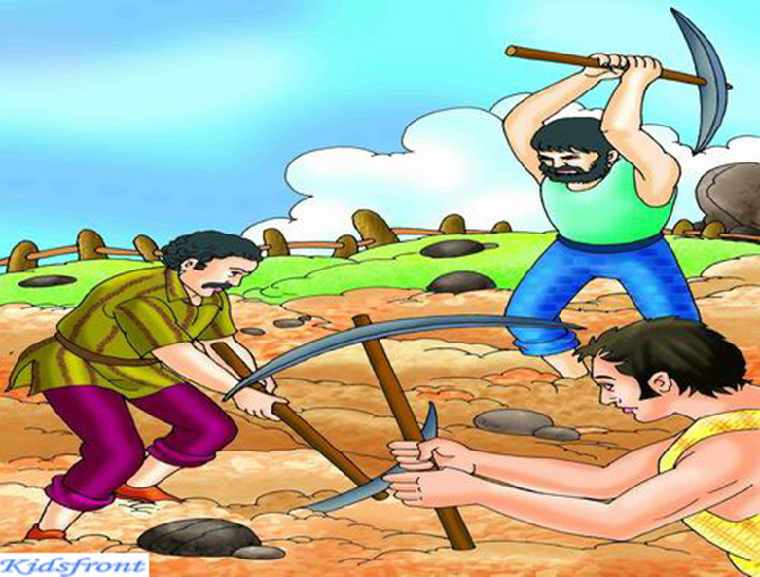
Work hard

Slide 14
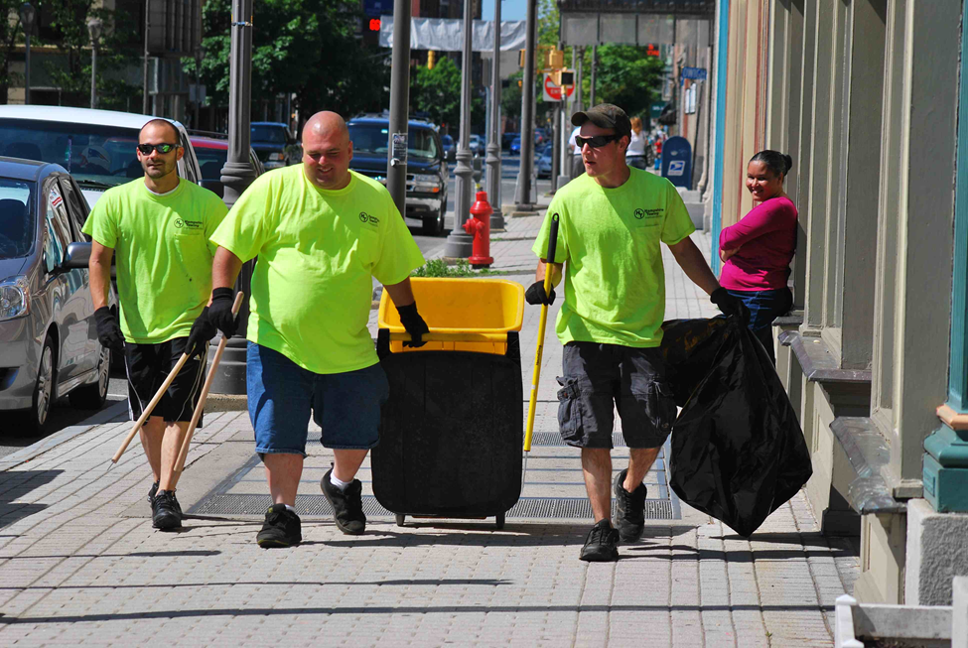
Clean the city

Slide 15
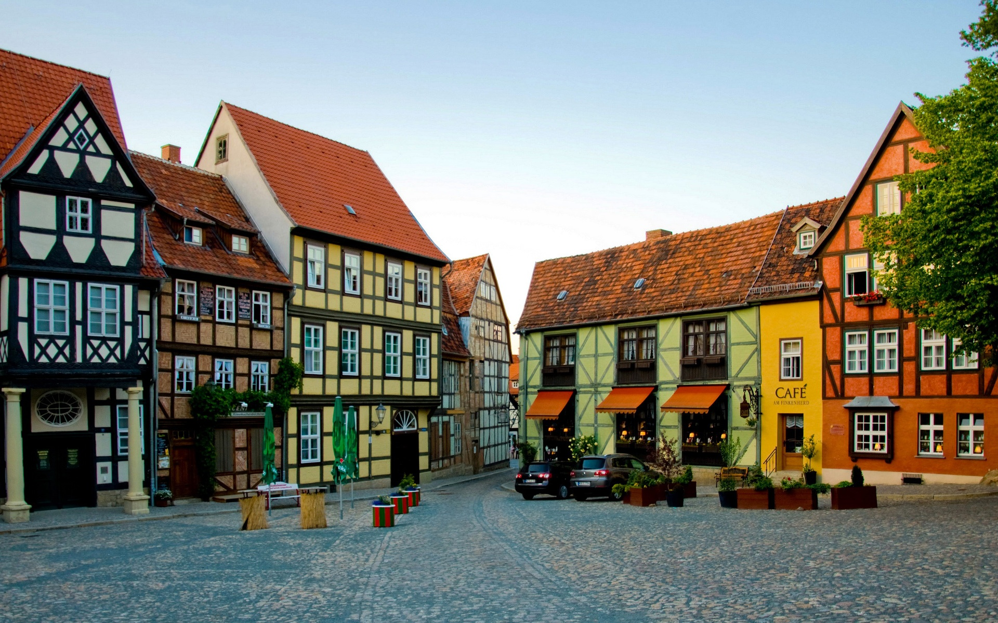

Town/City

Slide 16
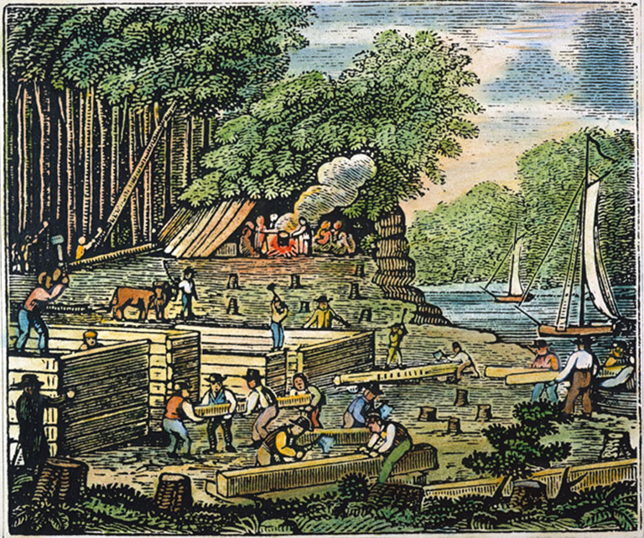
Colony

Slide 17

Live together

Slide 18
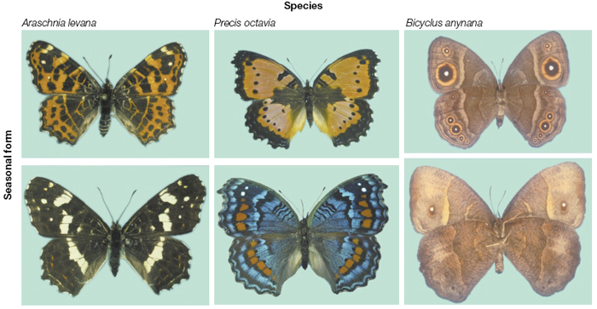
Species

Slide 19
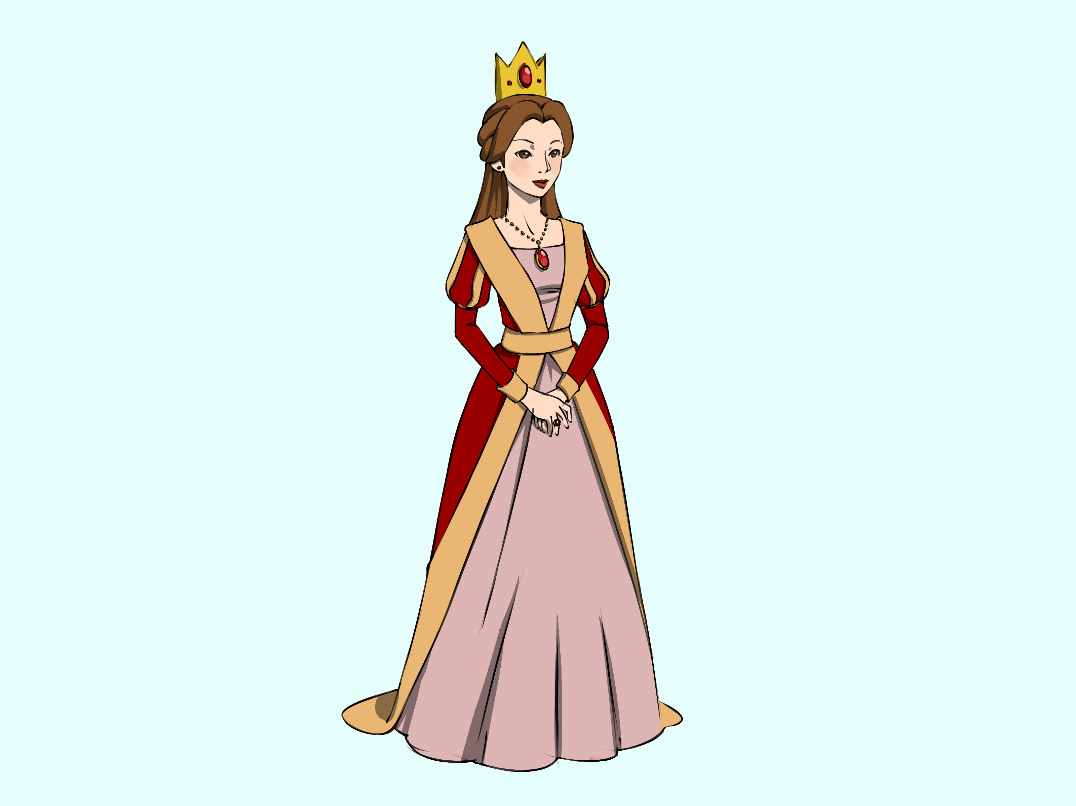
Queen

Slide 20
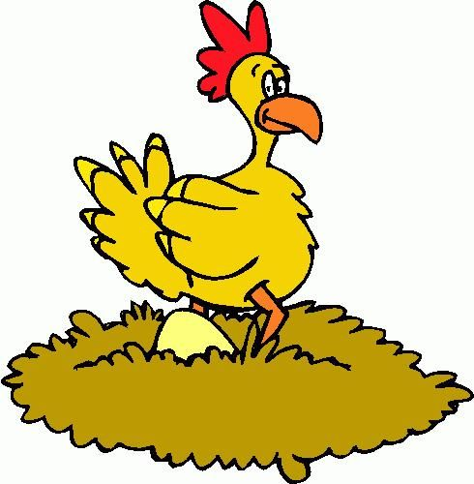
Lay eggs

Slide 21
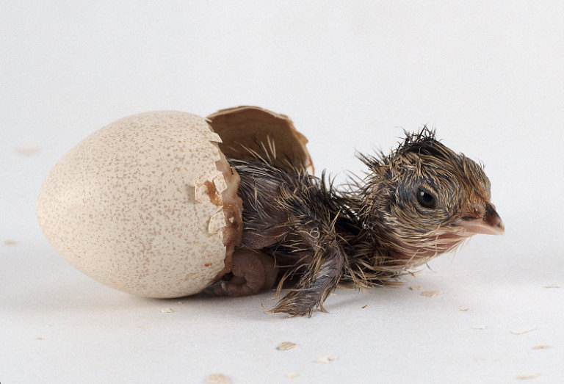
Eggs hatch

Slide 22
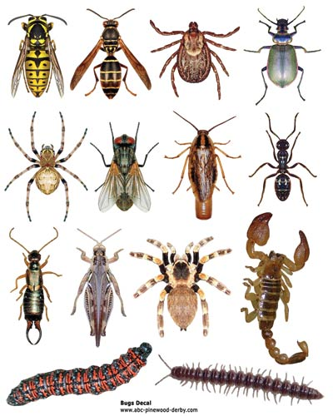
Bugs/insects

Slide 23
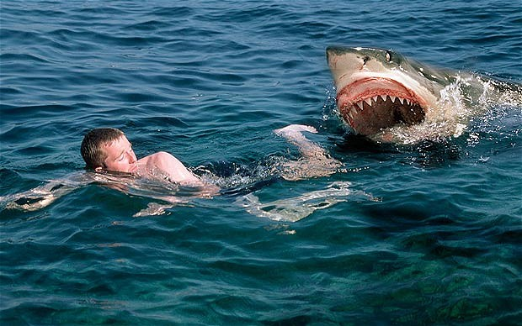
Attack

Slide 24
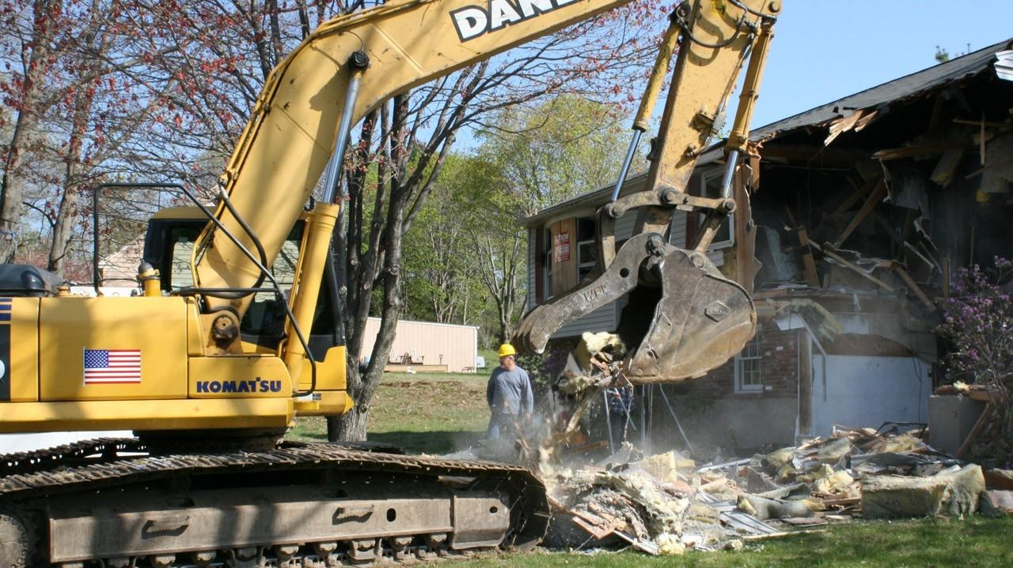
Destroy

Slide 25
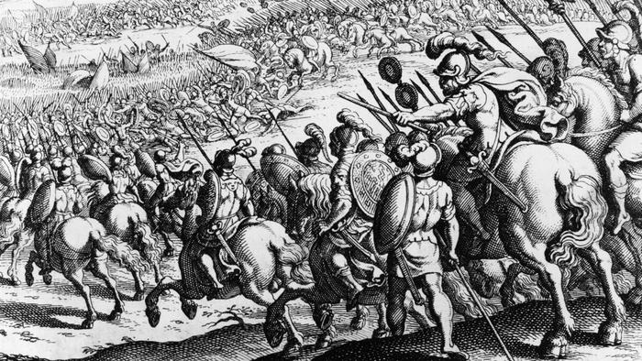
Conquer

Slide 26

Carry away

Slide 27

Wide

Slide 28
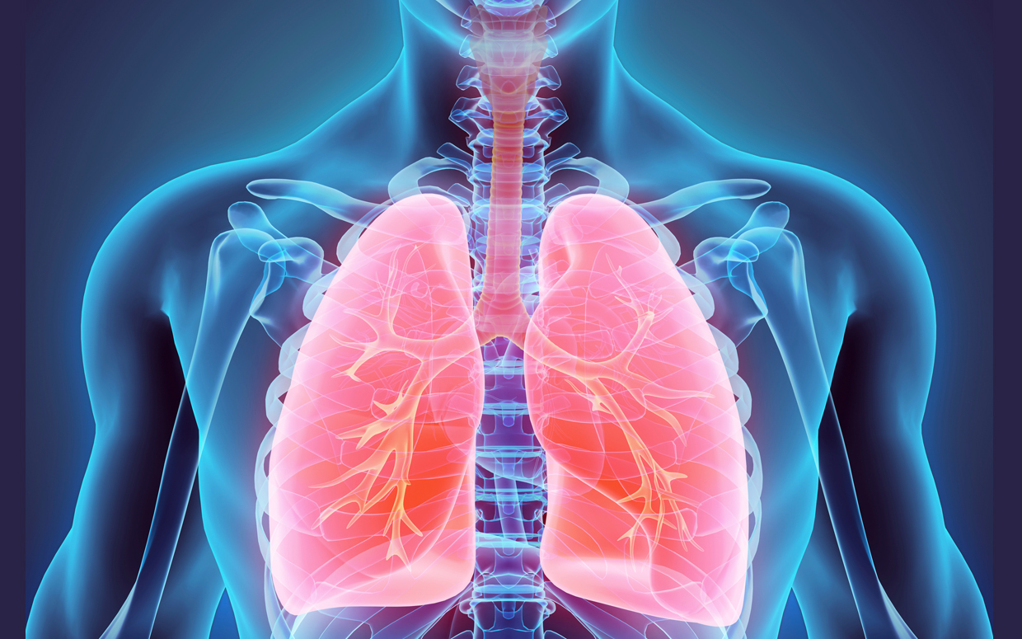
Lungs

Slide 29
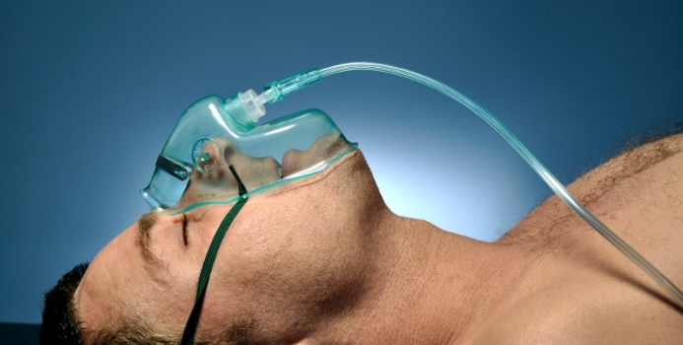
Oxygen

Slide 30
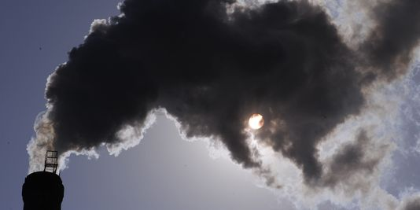
Carbone dioxide

Slide 31

Stomach

Slide 32
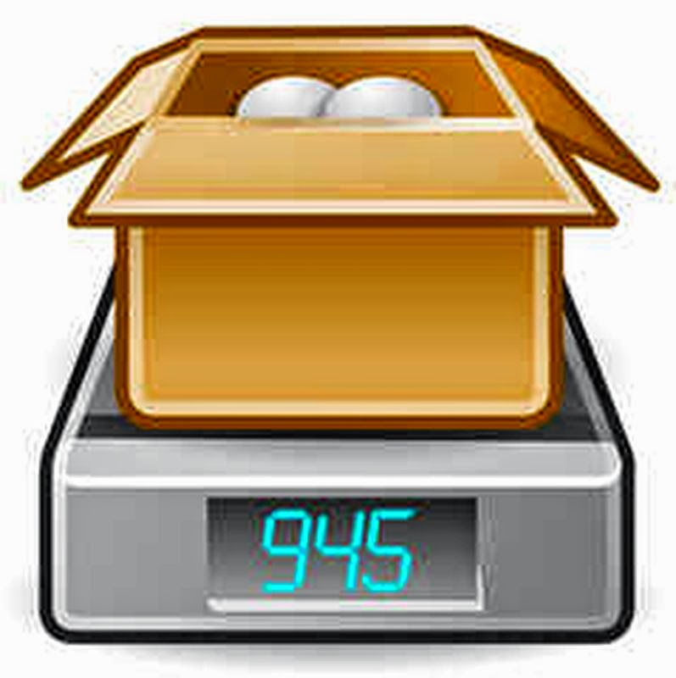
Total weight

Slide 33
The stories about ants
Žiogas ir skruzdėlė (rusų pasakėčia)
The Grasshopper And The Ant
https://www.youtube.com/watch?v=NWAIOuWoa6g

Slide 34
Lithuanian sayings about ants
Darbšti kaip skruzdėlė.
Hard-warking like an ant.
Nerimsta kaip ant skruzdėlyno sėdėdami.
Restless as sitting on an anthill.
Knibžda kaip skruzdėlynas.
Teeming like an anthill.
Tinka kaip skruzdėlei čeverykas.
It fits like a shoe to an ant.
Velka kaip skruzdėlė šapą.
Pull like ants pull the straw.

