Slide 1
FLYING OBJECTS

Slide 2

PLANE
WING
TAIL
NOSE
PORTHOLE
COCKPIT
ENGINE

Slide 3
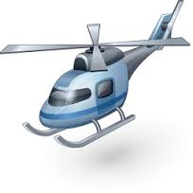
HELICOPTER
TAIL
BLADE
LANDING SKID
COCKPIT

Slide 4

ROCKET
FINS
NOSE CONE
ENGINE
BODY TUBE

Slide 5
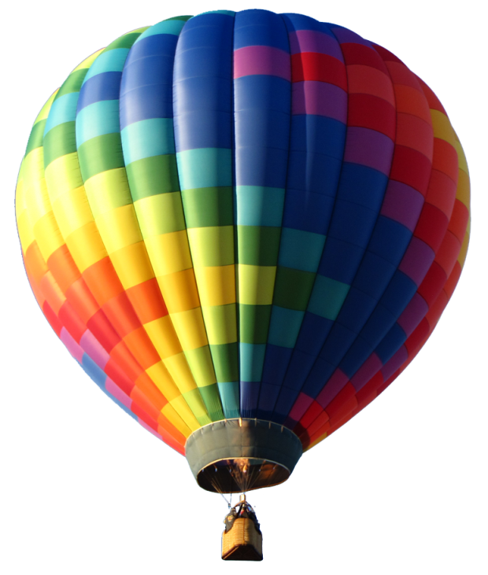
BALLOON
ENVELOPE
BASKET

