Slide 1



EXPLAINING AND EXEMPLIFYING
MATERIALS SELECTION AND ADAPTATION
TIPS FOR THE LESSON PLAN
TEACHER : EMMA ABBATE

Slide 2
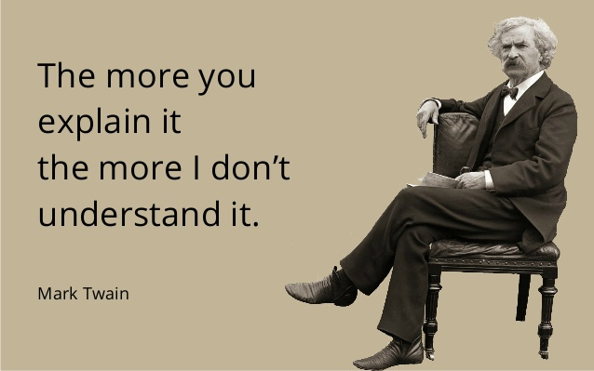
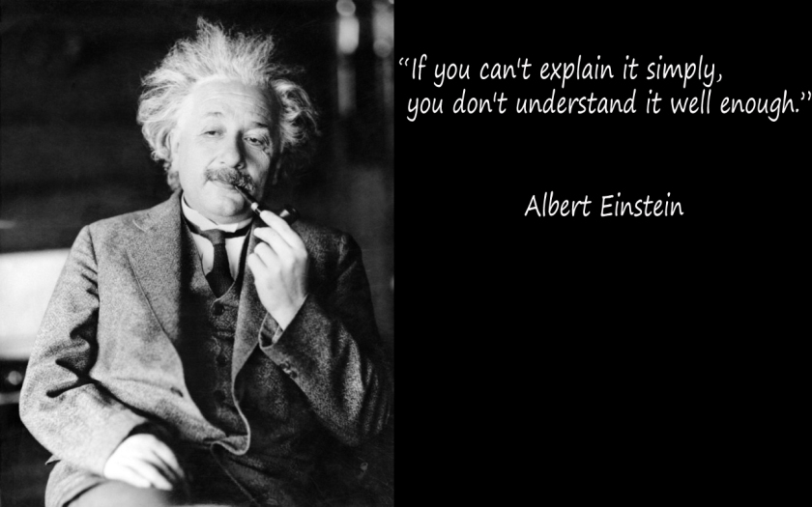
CLIL ‘S TEACHERS MOST DIFFICULT CHALLENGE: MAKING IT SIMPLE

Slide 3

PREDICT PROBLEMS
LOTS OF TOPICAL NEW WORDS:
PRETEACH (WORD BARS- GLOSSARIES)
PROVIDE MEANINGS
CREATE POSTERS
ADOPT MIND MAPS TO STIMULATE PRIOR KNOWLEDGE
ASK YOUR STUDENTS TO REPEAT THE EXACT PRONUNCIATION

Slide 4

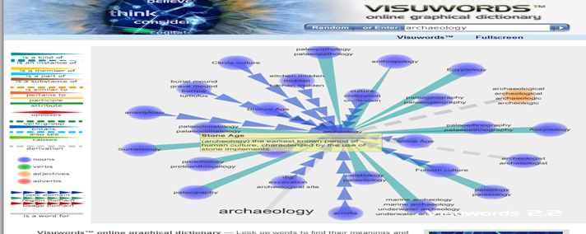
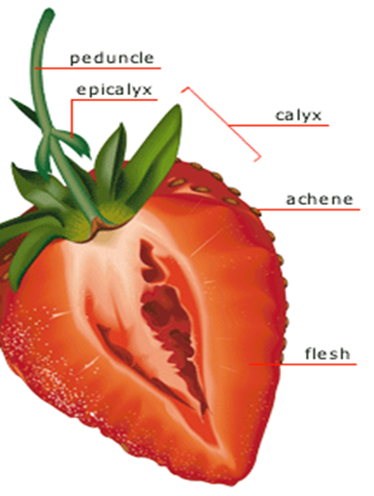
USE ONLINE DICTIONARY FOR LAST MINUTE TRANSLATIONS, EXAMPLES AND DEFINITIONS
http://www.howjsay.com/ www.wordreference.com
Free online Talking Dictionary of English Pronunciation. Type of activities:
Word clouds, flashcards, identifying images, matching concepts and definitions, synonyms and antonyms, etc.
Use graphic support whenever possible:
http://www.visualdictionaryonline.com/ http://www.visuwords.com

Slide 5

COMPLEX CONTENT TO EXPLAIN:
MAKE THE IMPOSSIBLE POSSIBLE
PUT IN ORDER IDEAS
USE SEQUENCING EXERCISES
CHECK TASKS
DIFFERENT LEVEL OF ENGLISH COMPETENCE AMONG STUDENTS
WORK IN PAIR EXERCISES. EXPLAIN A CONCEPT TO YOUR CLASSMATE. THINK/PAIR /SHARE ACTIVITIES
ADAPT ACTIVITIES ACCORDING TO THE LEVEL

Slide 6
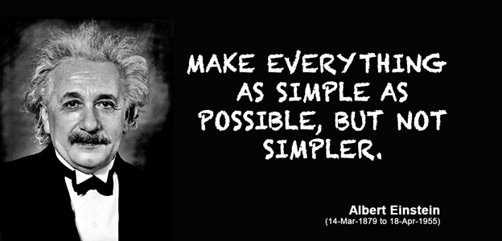
DON’T SIMPLIFY THE CONTENT OF YOUR LESSON TOO MUCH. MAKE IT SIMPLE NOT SIMPLER
Don’t water the content
Remember that when you are explaining you are answering to these questions: What? Why? who? where? When? Model your explanation on those questions.
Start your lesson by asking the questions you will answer

Slide 7

EPLANATION’S HINTS
ARTICULATE WORDS, SPEAK UP, SLOW DOWN
USE SIMPLE SENTENCES (SUBJECT, VERB, OBJECT) AND VERBS IN THE ACTIVE VOICE RATHER THAN THE PASSIVE VOICE
ENGAGE YOUR PUPILS ACTIVELY ASKING THEM TO TAKE NOTES, FILL IN DIAGRAMS OR TABLE DURING YOUR EXPLANATION
MAKE PAUSES BETWEEN MAIN IDEAS TO VERIFY THEY ARE CATCHING THE POINT
DON’T TRANSLATE. USE THE SANDWICHING TECHNIQUE TO AVOID FRUSTRATION

Slide 8


USE VISUALS
PIE –T- BAR- FLOW CHARTS
TABLES
LINE GRAPHS
STORYBOARD (www.storyboardthat.com)
TIMELINE (http://www.dipity.com/)
PICTURES FROM GOOGLE
POWER POINT SLIDES

Slide 9

HOW TO STRUCTURE SIMPLE AND EFFECTIVE EXPLANATIONS
INTRODUCE THE TOPIC
MARK THE END OF A SECTION
USE ANALOGIES
GIVE EXAMPLES
REFER TO VISUALS AIDS
CHECK FOR PARTECIPATION
AT THE END SUMMARIZE BY REPEATING
THE KEY CONCEPTS
IN ONE WORD: SCAFFOLD!

Slide 10

Key attributes of good scaffolding
Available for Just-in-time learning
Skippable by those who don’t need it
Blends content and structure to an appropriate degree
Fades like the ALICE Cat smile as students become more adept

Slide 11
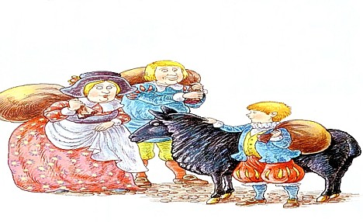
What makes a text 'easy' or 'difficult'?
Baa Baa Black Sheep
Baa Baa Black Sheep,
Have you any wool?
Yes, sir, yes, sir,
Three bags full;
One for the master,
One for the dame,
And one for the little boy
Who lives down the lane.
TASK
Discuss the opening line of “Baa Baa Black Sheep “in relation to the rural economy during Edward I ‘s Kingdom For solution:
http://www.dailymail.co.uk/femail/article-1045841/Why-does-weasel-pop---secret-meaning-best-loved-nursery-rhymes.html#ixzz3hrUnm2HX

Slide 12
READ THE TEXT BELOW THEN FILL THE CHART
Opposite idea | Socialist or communist idea
Working alone, to improve your life. | Working together
Individuality | Solidarity
Privileges
Class-based society
Wealth for the minority
A society of individuals
A 'free' society
The bourgeoisie control the proletariat
The bourgeoisie control production
TASK
The German philosopher, Karl Marx, went further than socialism. He thought that Liberalism was 'false liberty' and thought that the famous 'Declaration of the Rights of Man' of 1789 was focused too much on the individual. The individual had liberty, but to do what? Marx wanted society to be communal and controlled, not individualised. He thought that eventually the proletariat would come to dominate the bourgeoisie and then control the means of production.

Slide 13



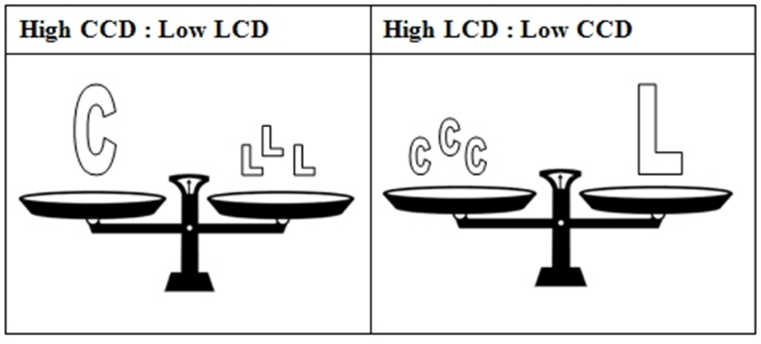
THE TASK ASSIGNED TO A TEXT DETERMINES THE LEVEL OF DIFFICULTY JUST AS MUCH AS THE TEXT ITSELF.
Provide appropriate tasks at your students’ level . You can make a text easier or more difficult by providing different levels of tasks. And these tasks need to match the students, rather than the text.
Complex texts: making them easier
If the content of a new topic is unknown, you should focus on the content more than on language. In other words, the content cognitive demand (ccd) is high. To make sure the content is understandable, the language cognitive demand (lcd) should be low.
Notes:
How to select content:
Concrete versus abstract content
That allows students to practice communicative skills
Of interest for the students and their world
Cross-curricular
Language and discourse models not too far from the students’ language competence.
The subject determines the specific language we use: use the L2 but from the content p.o.v (not dealing with grammar, etc.).

Slide 14
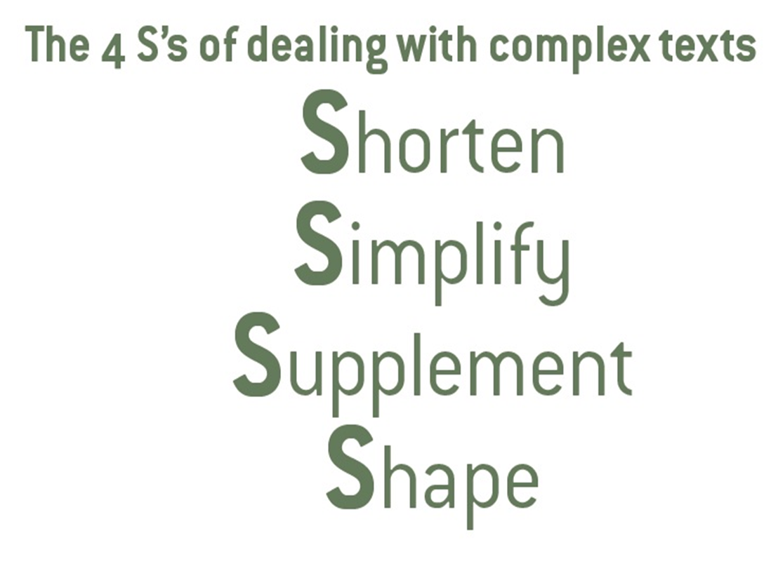
CREATE AND ADAPT YOUR OWN TEXT FOR LESSON EXPLANATION

Slide 15

SHORTEN
Divide long, complicated paragraphs or sentences into two or more shorter pieces.
Just one idea per paragraph and one piece of information per sentence.

Slide 16

SIMPLIFY
no more than 15 new words per page if you want students to pick up language and ideas from the text.
reading strategy of ignoring words: students can learn that they can understand a text even if they do not understand every single word.

Slide 17
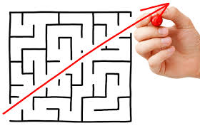
GRAMMAR TIPS TO SEMPLIFY
1. Use simple sentences (subject, verb, object) and verbs in the active voice rather than the passive voice.
2. Use positive language and avoid negatives (e.g. expressions like can’t, won’t, unable to).
3. Use simple and commonly used verb tenses such as present, simple past and simple future, rather than conditionals or the past perfect (continuous!).
4. Don’t turn verbs into nouns: for example, don’t write ‘animal protection procedure Development,’ but ‘developing procedures to protect animals.’
Avoid the following, if possible:
1. pronouns because the reader has to infer to what subject they refer.
2. inversions between verb and subject, e.g. ‘Into the room slipped a giant crocodile.’
3. abstract concepts (ideas or concepts that have no physical reference), e.g. freedom, justice, sexism.
4. metaphors and figures of speech. If necessary, illustrate them with practical examples.
5. synonyms, abbreviations and acronyms.
6. excess words, e.g. Write ‘difficult’ instead of ‘particularly difficult.’

Slide 18

SUPPLEMENT
Find multimodal input: a visual (picture, photograph, reproduction of a piece of art), an interesting video, or additional visual keys, such as data, charts or graphs.
Write an extra introduction. It might include: a summary of the whole text, some background information, an explanation of why the text is interesting, or instructions on how they should read the text and what they should look for.
Add markers to the text
Give examples
5. Add headings and sub-headings

Slide 19
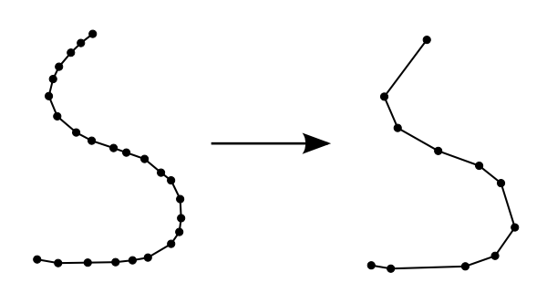
PROVIDE PRE READING TASKS
Giving tasks after students have read a text is a memory test. Giving tasks before reading gives students a reason to read (to do the task), and helps to develop reading skills and strategies like predicting, skimming, and scanning.
1. Ask students to put pictures about the text into the right order.
2. Find and discuss or ask questions about a picture which is closely related to the
text.
3. Ask students to match pictures to words.
4. Discuss what the title of the text might mean.
5. Talk about which words or ideas might appear in a text with this particular title.
6. Provide 10 words from the text and invite students to guess what the text might be
about.
7. Ask students to predict the answers to true/false questions about the content.
Don’t tell them the answer: they find the answers themselves while reading the
text.

Slide 20
Pre-teach content and/or language
1. Write on the board, explain and illustrate the vital new keywords that students
need to know in advance.
2. Ask students to guess the story or contents of the text from the pre-taught new
vocabulary.
3. Put the new key words on the board: students guess their meaning.
4. After you have pre-taught the keywords, ask students to predict other words
which might appear in the text.
5. Pre-teach a grammar point in the text (e.g. conditionals if the text is about a
hypothesis, or comparisons if the text discusses similarities or differences between
concepts).
6. Talk about cultural information which students might not be aware of.

Slide 21
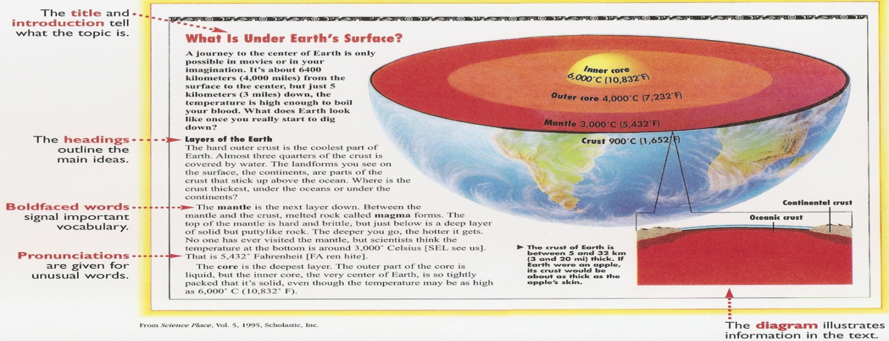
SHAPE
The fourth S involves looking at the shape of a text - its format and layout. A clear layout helps reading considerably, too. Here are some layout tips:
1. Present related points in a list rather than a long paragraph.
2. Avoid many columns on one page.
3. Use numbered lists rather than bullets.
4. Create more space between lines (1.5 to 2 times line spacing).
5. Don’t split words at the end of the line – this can slow down reading speed and rules about splitting words in English are complicated.
6. Illustrate your input. Use pictures, icons and symbols. Illustrations must be clear, precise and in colour if possible and be accompanied with a brief and simple explanatory text and title.

Slide 22
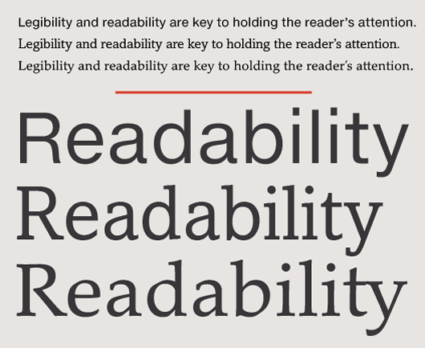
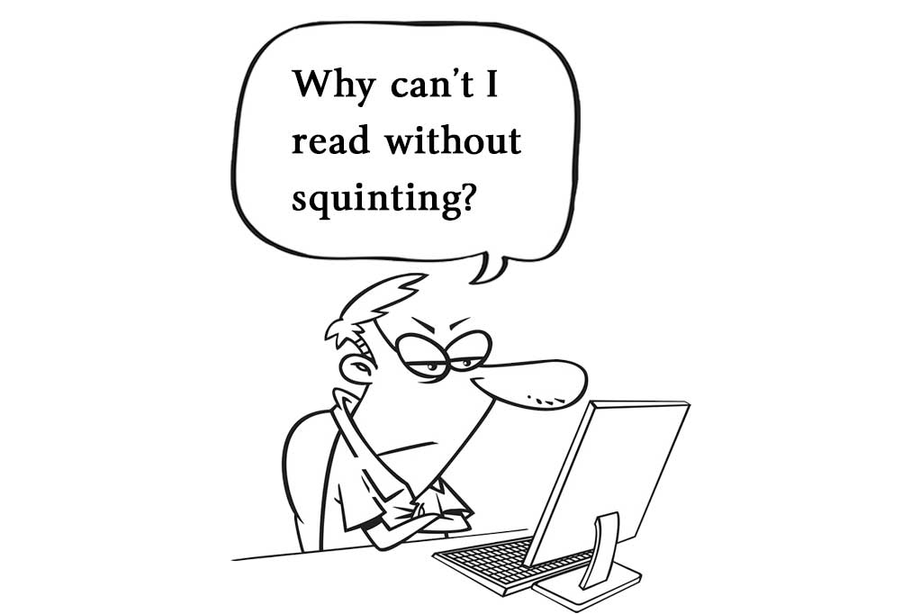
READIBILITY:
Let's make the unreadable readable
Check how readable the text you have chosen is before giving it as study material to your students.
Use: http://read-able.com/ a free readibility test tool

Slide 23

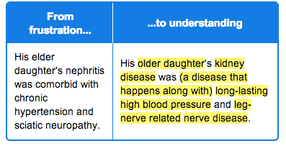
REWORDIFY your web text now!

Slide 24


SELECT AND ADAPT YOUR TEXT AND CREATE ACTIVITY
Choose a web page text with a low readability level (test it by http://read-able.com/) which you would like to use for your assignment topic in a CLIL lesson and make it more accessible to your students providing pre-reading tasks and shaping its format and layout to make it clear. Follow the 4 S’s MODEL and use https://rewordify.com/. Copy both ‘before’ and ‘after’ texts in the forum dedicated area. To complete your task you can add graphical organizers collected in the Moodle Lab Area and all the multimodal input you gather in the web as supplement. (picture, photograph, reproduction of a piece of art, an interesting video, additional visual keys, such as data, charts or graphs, and so on). F

