Slide 1

3. SPEAKING AND WRITING ACTIVITIES

Slide 2
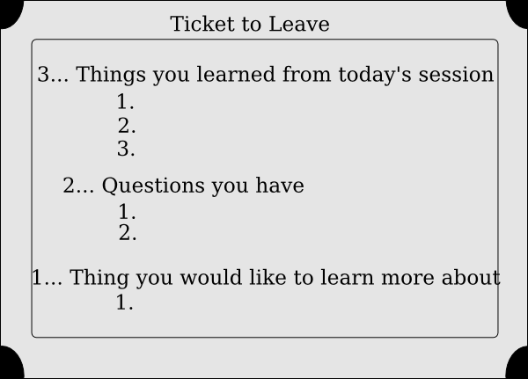

Slide 3


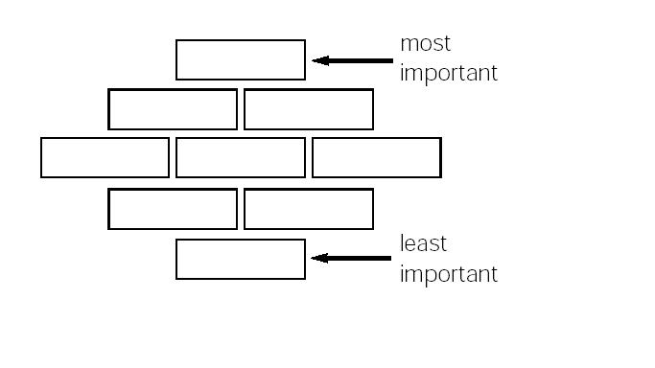
DIAMOND RANKING ACTIVITY
Go to http://www.firstworldwar.com/weaponry/
In group of 4 order in the diamond diagram below the WW1 weapons according to their destructive capabilities. Explain the reasons of your choice

Slide 4
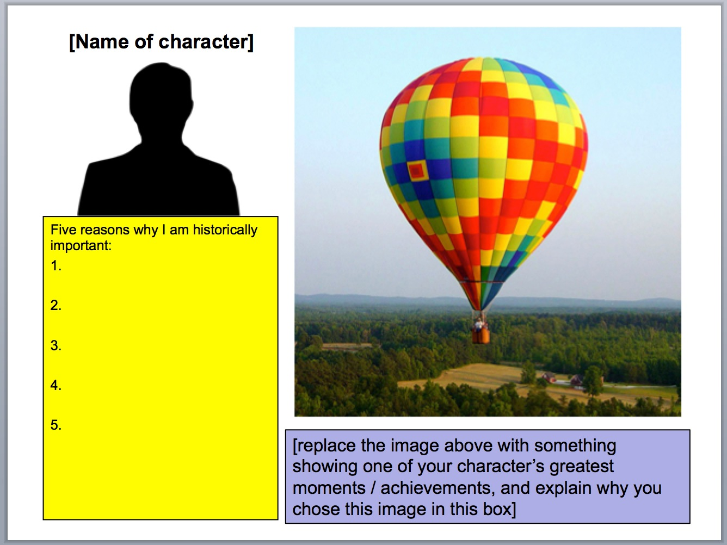
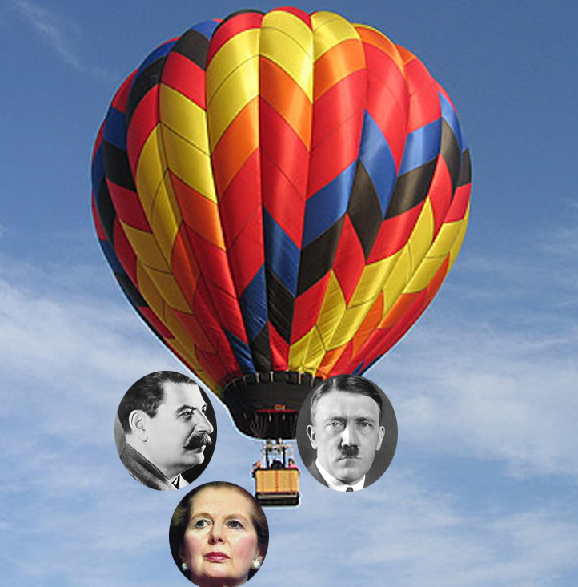

BALLON DEBATE

Slide 5
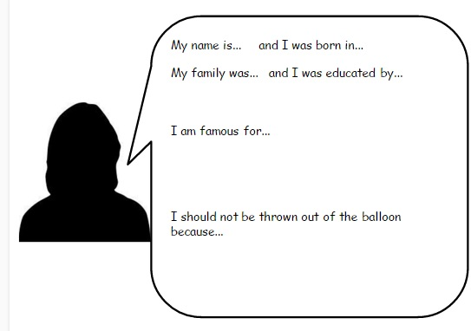

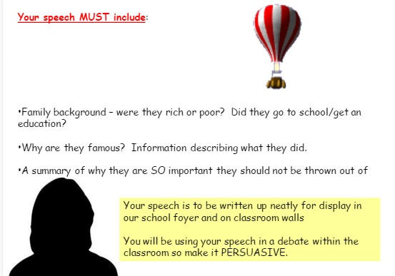
BALLOON DEBATE. RENAISSANCE
What is a Balloon Debate
The idea of a balloon debate is ​simple. Imagine that you are ​the famous Renaissance person ​you have been given and you are ​in a hot air balloon. The balloon ​is going down. ​You have to give a speech to say ​why you are most important and ​should not be thrown out of the ​balloon.
We need to lose weight by ​getting rid of someone.

Slide 6
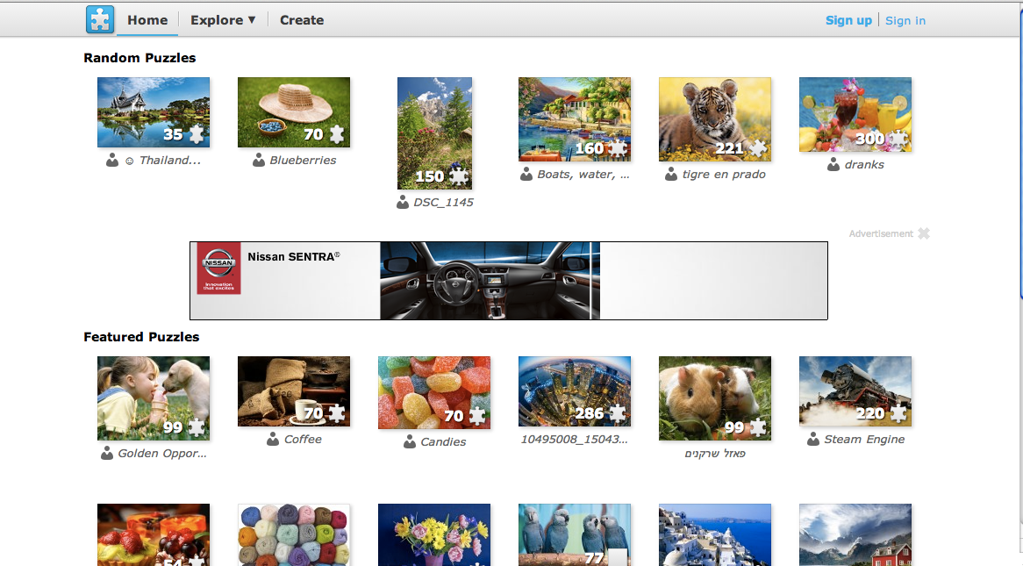
http://www.jigsawplanet.com/
HISTORY EXAMPLE: Medieval armour with labels names of parts http://www.jigsawplanet.com/?rc=play&pid=2491bea2f598

Slide 7
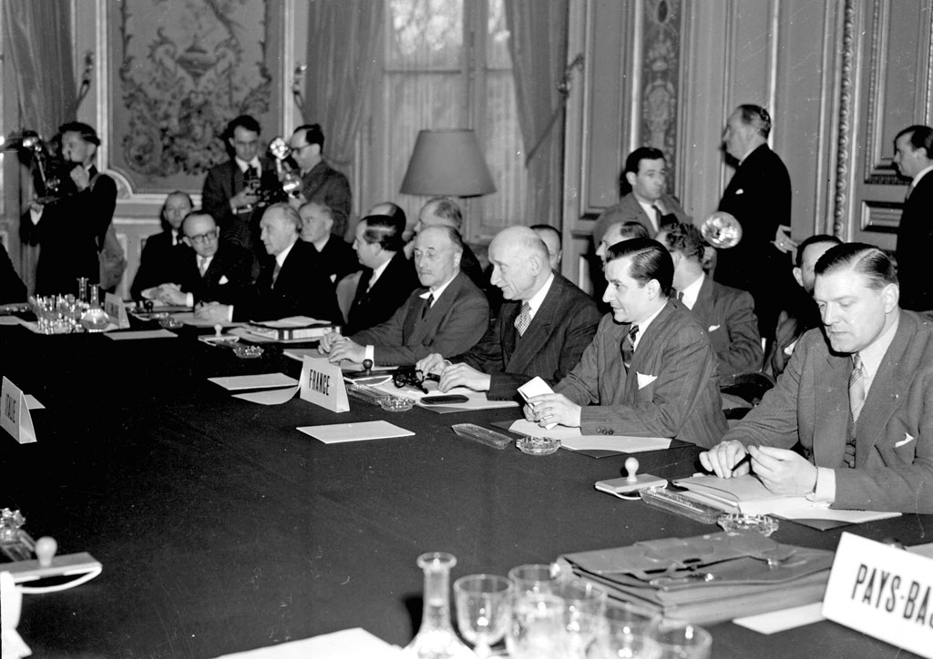
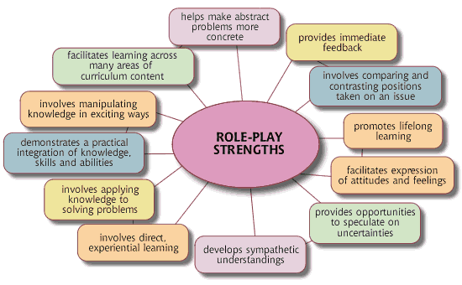
ROLE PLAY
Role play: Interview of Churchill, Marshall, Schuman and Monnet (in pairs).
Each group chooses one of these politicians. One of you will be the interviewer and the other one the man of state. Be sure to ask and answer the following questions according to the information I am providing you with. The first one has been done for you as an example.
Place/date of born: Where and when were you born, Mr. Churchill?
Childhood/youth/studies:
Position/public office:
Political attitudes during I World War/the Interwar period/II Wold War:
Writings/works/other activities why they are known and its most important achievement:

Slide 8
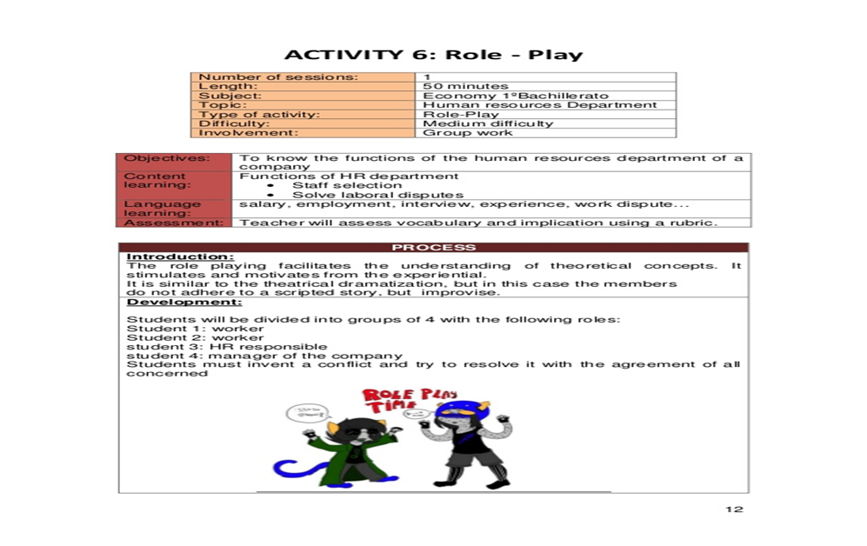

Slide 9
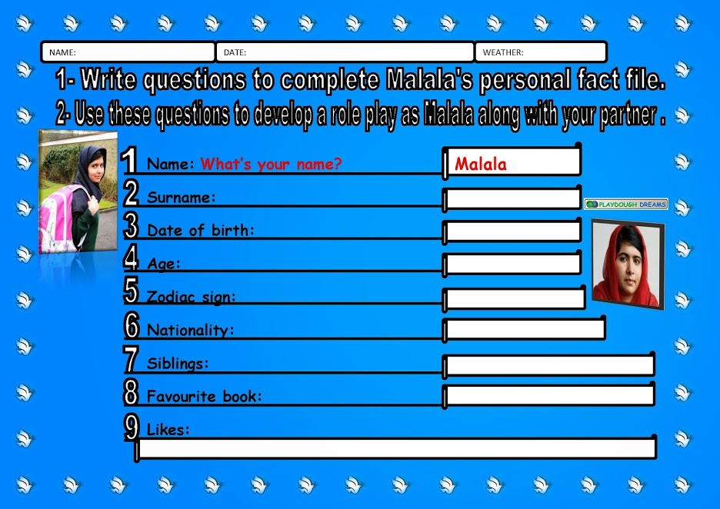

Slide 10
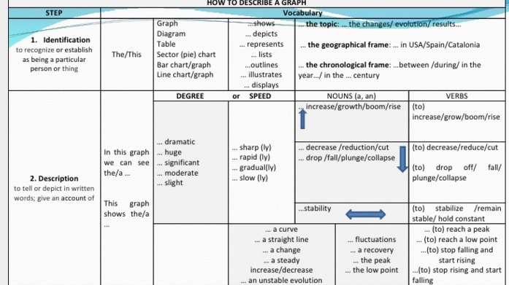
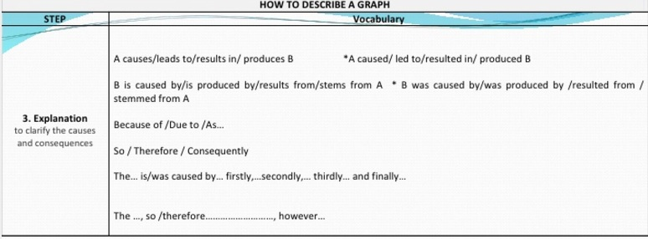
DESCRIBE A GRAPH
According to the patterns for description students apply the 3 steps: identification, description, and explanation

Slide 11
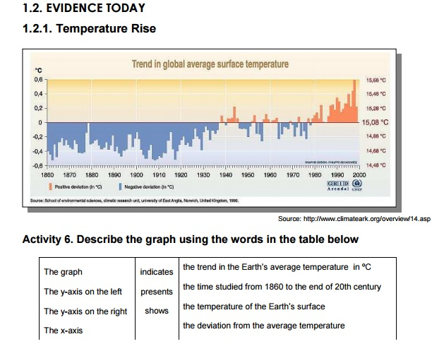

Slide 12
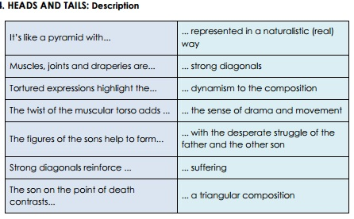
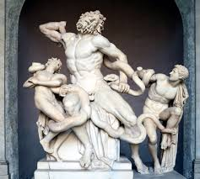
HEAD AND TAILS DESCRIPTION

Slide 13
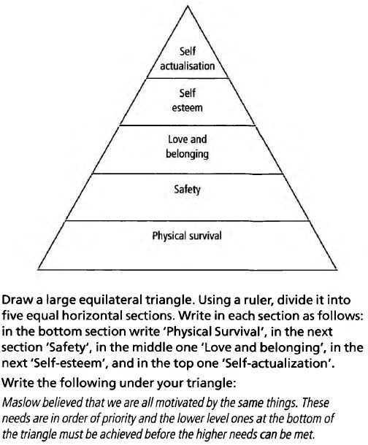
VISUAL DICATION
ECONOMICS: Maslow's Hierarchy of Needs

Slide 14
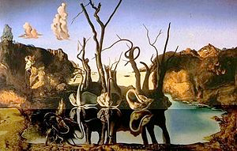
DESCRIBE AND DRAW
Describe and Draw(Practices giving instructions, describing objects, describing position ­under, near, next to, to the left of, etc.) Students work in pairs, and each has a blank sheet of paper and drawing materials. Student A describes to Student B what he or she is drawing, and Student B reproduces the drawing according to A´s description. This is a barrier game ­ they should not be ablet o see each other’s work.
EX: https://www.teachingenglish.org.uk/article/clil-art-dali
Swans Reflecting Elephants by Salvador Dalì.

Slide 15
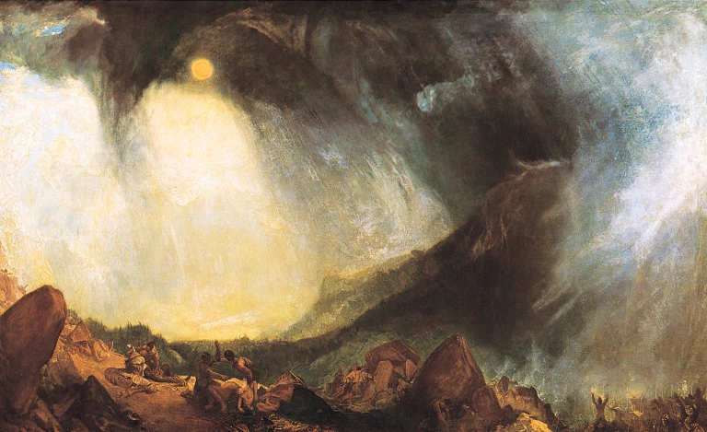
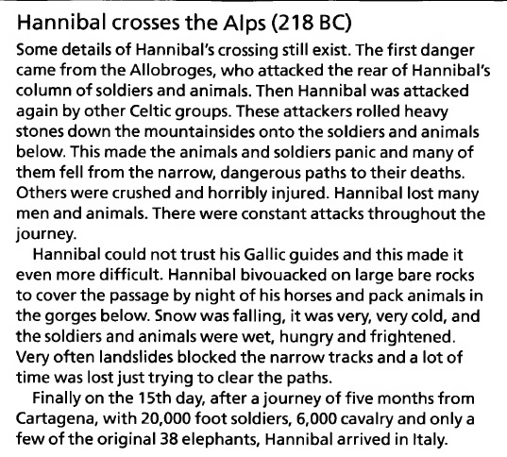
ANSWER MY PICTURE QUESTIONS
M.W. Turner – Snow Storm: Hannibal and his army crossing the Alps, 1812.
SHARE THIS:

Slide 16
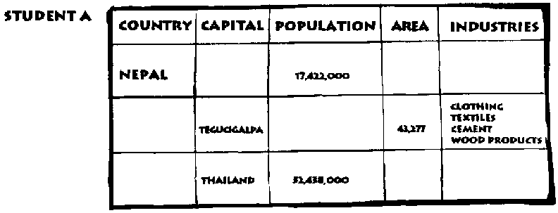
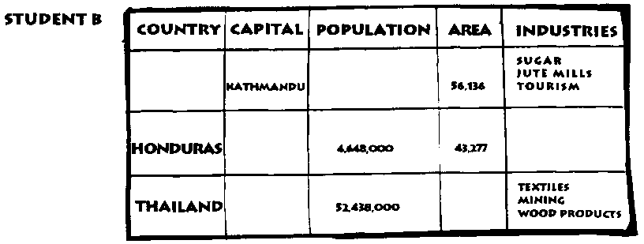
INFORMATION GAPS ACTIVITY
An information gap activity is an activity where learners are missing the information they need to complete a task and need to talk to each other to find it.
Example
Learner A has a biography of a famous person with all the place names missing, whilst Learner B has the same text with all the dates missing. Together they can complete the text by asking each other questions.

Slide 17
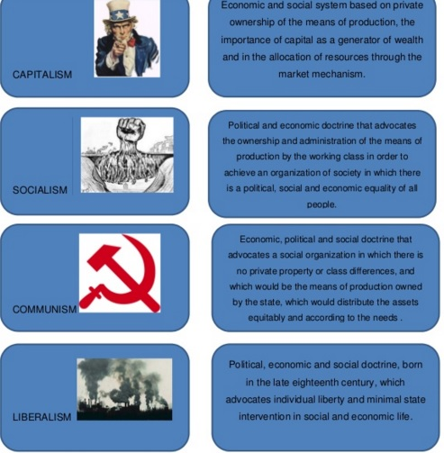
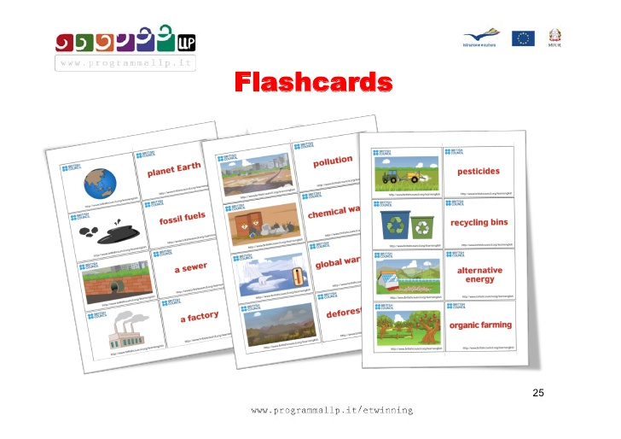
FLASH CARDS
Flashcards are a kind of laminated cardboard that are especially useful for presenting new vocabulary, review, create stories, stimulate discussions ...
Ex: ECONOMICS GEOGRAPHY

Slide 18

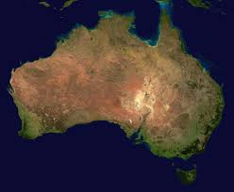
ADD TO THIS
Add new words to a previous sentence working in group
EX: GEOGRAPHY Topic: Australia
Australia is an island.
• Australia is an island with deserts.
• Australia is an island with 30% desert.
• 30% of Australia is made up of desert.
• Australia has 30% desert and 40% tropics.
Australia is an island with 30% desert and 40% tropics as well as
30% marginal grazing.
• Australia has 30% desert and 40% tropics as well as 30% marginal
grazing,

Slide 19
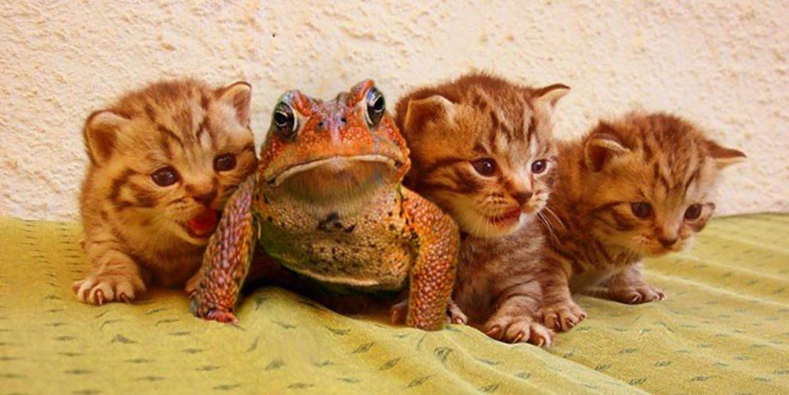

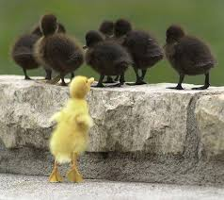
ODD ONE OUT
Tell the students to write down all the words you dictate .Ask Ss, in pairs, to underline the “odd one out” in each list.
Ask a volunteer to write down the words from the first list.
Call one pair to the board. They underline the “odd one out” and give a reason for their choice: The___________is the odd one out because it is/isn’t/has/hasn’t/can/can’t________________
GEOGRAPHY: Tsunami, Volcano, Flood, Earthquake
ECONOMICS: Inflation- Deflation- Recession- Crisis
HISTORY: Odd one out activity (work in pairs and compare answers with your partner)
In this activity, you have four sections. Each section has five terms, four of them correspond to
the same category, and one is unrelated to the others.
• First, find the odd one on each list.
• Second, say which category matches each section.
a) Atrocities, ravages, agreement, devastation, destruction 1) Post war period
b) Integration, cooperation, compromise, weakness, concord 2) Neutral countries
c) Spain, Switzerland, Ireland, Italy, Portugal 3) War effects
d) France, Germany, USSR, Sweden, USA 4) Countries participating at war

Slide 20
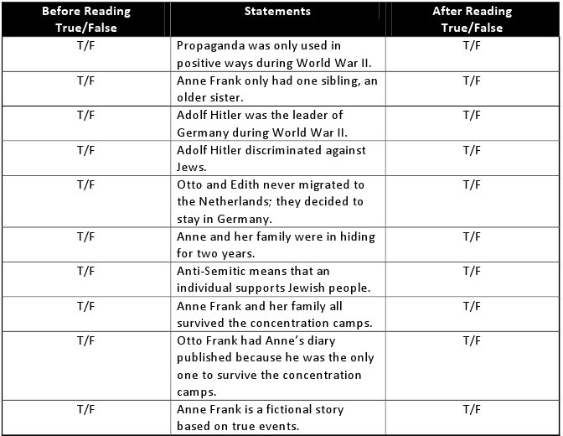
ANTICIPATION READING GUIDE
Predict what the text will be about. Decide weather the given statements are true or false.
Prepare some true and false statements about the key ideas of the text learners are going to read.
Learners have to read the statements and decide weather they are true or false and tick the appropriate column before reading the text.
Version. After learners have completed the prediction part read the statements and discuss them. The emphasis is not on right answer but to share what learners know and to make predictions.
When learners have completed the grid they receive the text.
They read it and check if their predictions were correct and mark the columns after reading.

Slide 21
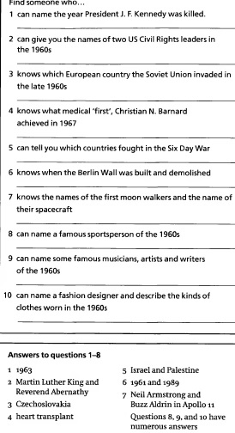


FIND SOMEONE WHO…..
Students walk around the class searching students that are able to comment on /answer some sentence or questions.

Slide 22
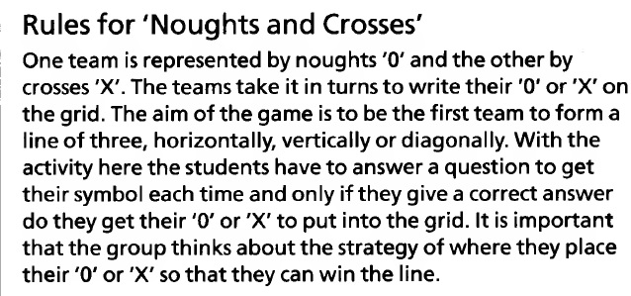
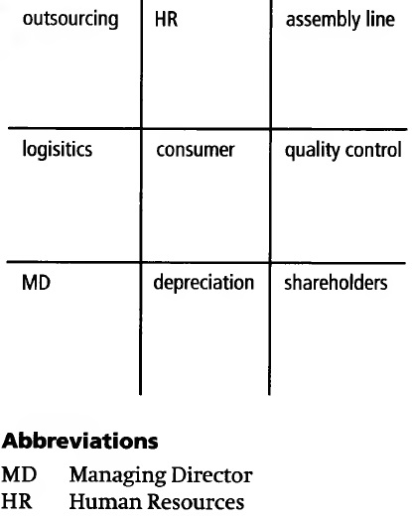
NOUGHTS AND CROSSES
SUBJECT: ECONOMICS Topic: Business abbreviations and terms

Slide 23
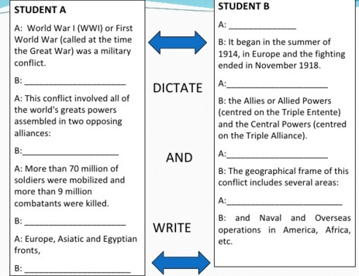
MUTUAL DICTATION
Find a text that gives key information. Divide it up into alternate A and B sentences.
On one sheet copy the A sentences, leaving the B lines blank. Do the reverse on the other sheet.
Photocopy the sheets in order to have enough A and B sheets for making pairs of students.
Give half of the class the A sheets and the other half the B sheets.
Give the students time to read and understand their sentences.
Clarify any new words.
Ask the SS to pair with someone who has got the other part of the sheet.
Student A start by dictating their first sentence and student B writes. Then student B dictates their first sentence and student A writes (spelling is allowed). Then they check what they have written.

Slide 24
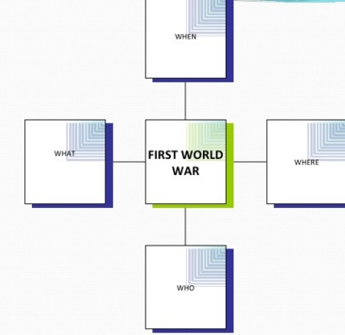
ASK ME YOUR QUESTION
Students ask w-questions about a topic

Slide 25
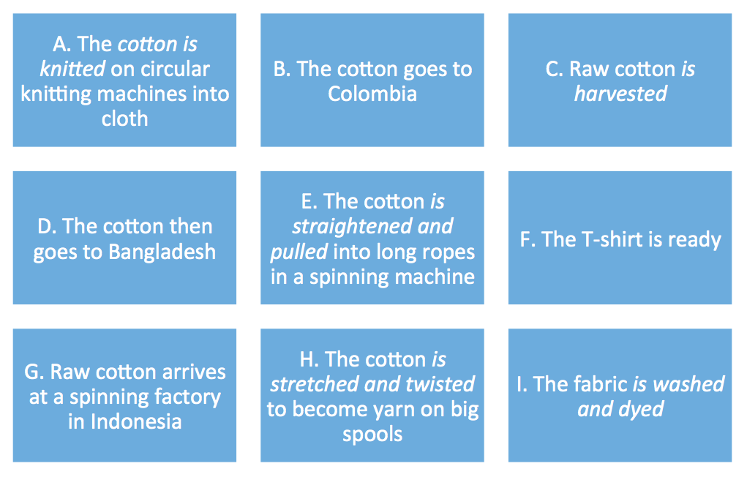
LET’S JUMBLE
List the main events on the video on cards. Jumble them up. Before pupils watch the video, ask them to guess the correct order. EXAMPLE: TOPIC: THE COTTON TRADE
SUBJECT/GEOGRAPHY.
https://www.youtube.com/watch?v=ZJOteam-zWw&index=3&list=PLp-wXwmbv3z8aAJrhyttiqPMiKy0WVJym.
Pupils then watch the video and check their answers.
Answer key: C, G, B, H, D, A, E, I, F

Slide 26
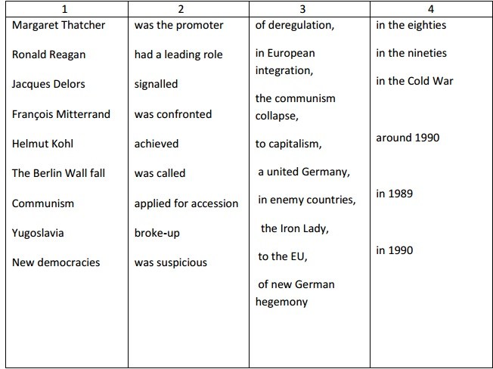

JUMBLED SENTENCES
HISTORY/ECONOMICS/ LAW:
Writing skills activity. Work in pairs using the table below to make sentences

Slide 27
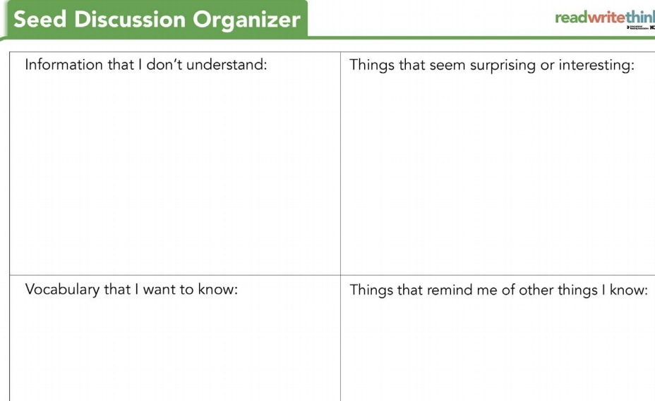

Slide 28

CREATE YOUR OWN MUSEUM
Instructions
You are going to work in groups of four students. Your local authorities are interested in creating a new classical sculpture museum and are gathering proposals for this museum. Each group has to prepare one proposal of 10 artworks for the new museum and make a public presentation in the classroom, justifying their choice and explaining the masterpieces. For the first and last time in your life money is not a problem.
Tasks. In order to achieve a successful outcome it is essential to pay attention to the following steps:
1. Individually, look over the following web pages and make your own choice about criteria and artworks.
2. In group decide what criteria you are going to use in order to choose the 10 masterpieces.
3. Apply your criteria and make your group choice of ten classical sculptures for the new museum.
4. Prepare a power point presentation explaining the criteria and the 10 artworks that you have chosen. Further information such as a plan of the exhibition room and the order of display is accepted.
5. Share the presentation and each member must have a role to develop, for instance: student a) global presentation including the criteria, student b) cataloguing the 10 masterpieces, students c) and d) each one describes one of the artworks using the patterns for description below.
WEB PAGES
http://www.beazley.ox.ac.uk/sculpture/styles/default.htm
http://eekman.com/virtual_gallery/sculptures.shtml
http://www.britishmuseum.org/default.aspx
http://www.metmuseum.org/
http://www.louvre.fr/llv/commun/home.jsp?bmLocale=en
http://www.christusrex.org/
http://www.grisel.net/acropolis_museum.htm
http://www.arthist.umn.edu/aict/html/ancient.html
http://witcombe.sbc.edu/ARTHgreece.html
http://www.historyforkids.org/learn/greeks/art/sculpture/greeksculpture.htm

Slide 29
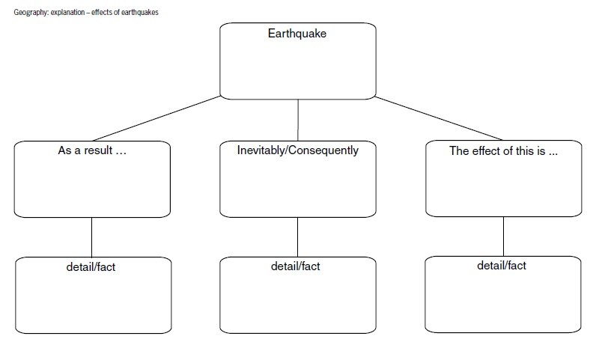
FRAMING WRITING
LEARNERS USE WRITING FRAMES AS PREPARARTION FOR WRITING

Slide 30
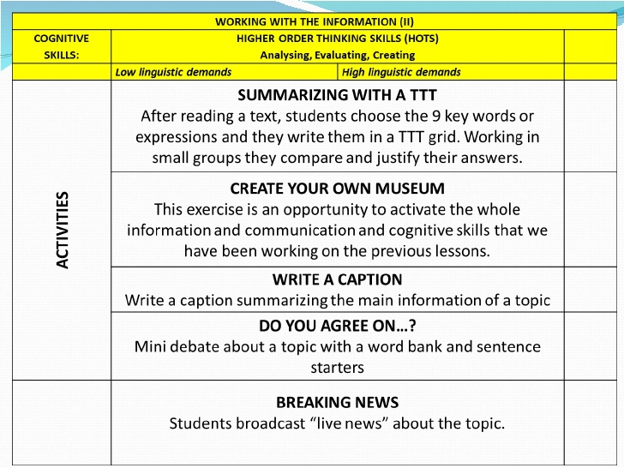

Slide 31
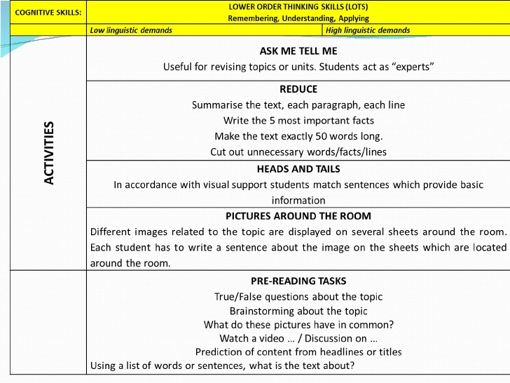

Slide 32


