Slide 1


ICT AND CLIL
TEACHER : EMMA ABBATE

Slide 2
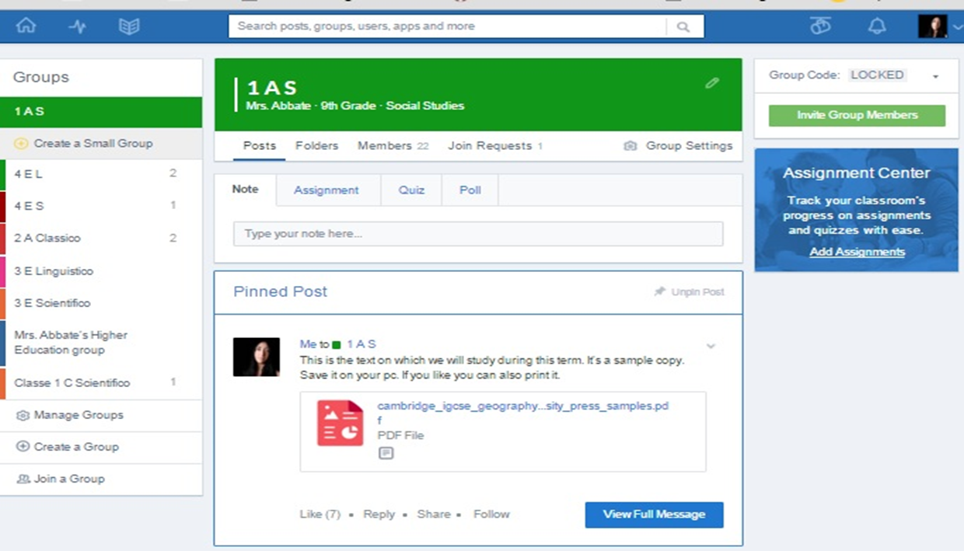
BUILD A LEARNING COMUNITY: EDMODO
Use the Web to host and share materials and to contact other teachers and students.
Edmodo is free and offers you a simple virtual learning environment where your students can share ideas and collaborate together. It has a very similar interface to Facebook and so your students will pick it up easily. What's more, students to do need provide their emails. You can create quizzes, polls, add up important dates to the calendar, run discussions and share links, videos, articles etc.

Slide 3


LET’S WIKI!
A wiki is a kind of "shell" that teacher and students can fill with content by collaborating in its construction.
To understand what a wiki is we could say that it is basically a collection of web pages designed to make sure that people have the opportunity to change them without having to know html language.
What to do then to use this tool for CLIL?
A wiki can host a Webquest (we will talk about webquest in the next slides)
Its blank pages may be used for a hypertext
It can be used to enter the input for a discussion.
It can be used to record the steps of an experiment
Can be inserted images, sounds, links to media files.
It can be a collection of information on a topic
It can be a collection of resources to be used for various tasks

Slide 4
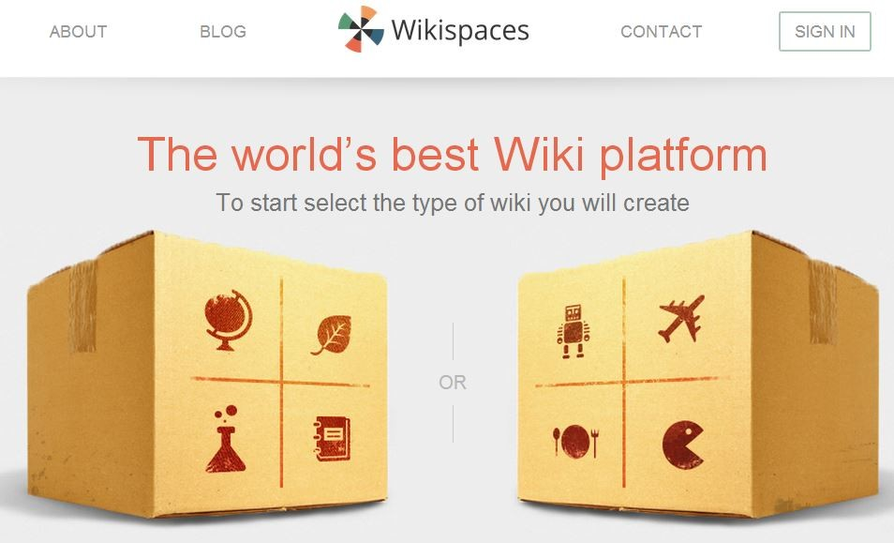
How to set up a class wiki on wikispaces in 3 easy steps
1 Register. Everyone creates their own account at Wikispaces: http://www.wikispaces.com
2 Create the wiki. One person then creates the wiki. This person will be the administrator of the wiki and can add and remove others.
3 Add Others: The wiki administrator adds the other users to the wiki so they can edit the wiki too.

Slide 5

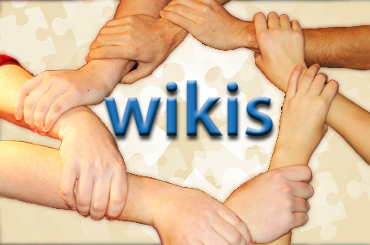
SOCIAL LEARNING
Collaborative Spaces / Social Software
Blogs (blogger.com, wordpress.com, educational applications of Google - sites.google.com) and Wikis (www.wikispaces.com) make learners active in the formation of their own knowledge , awakening in them the ability to select information online, favoring immersion in the learning process . They stimulate cognitive processes improving learner’s autonomy, and contributing to the CLIL’s aim: the transition from BICS to CALP . The cooperative dimension helps to assign to the teacher the role of marginal coordinator and facilitator as recommended by the CLIL theories.

Slide 6
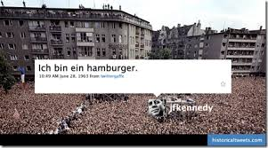
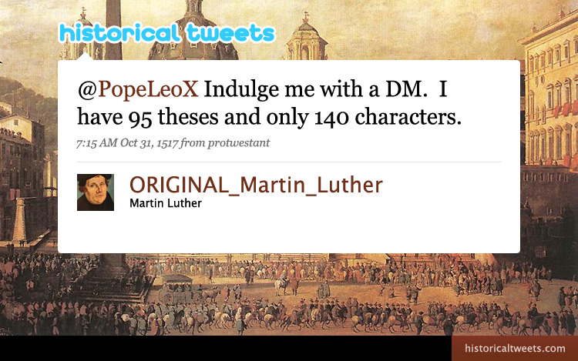
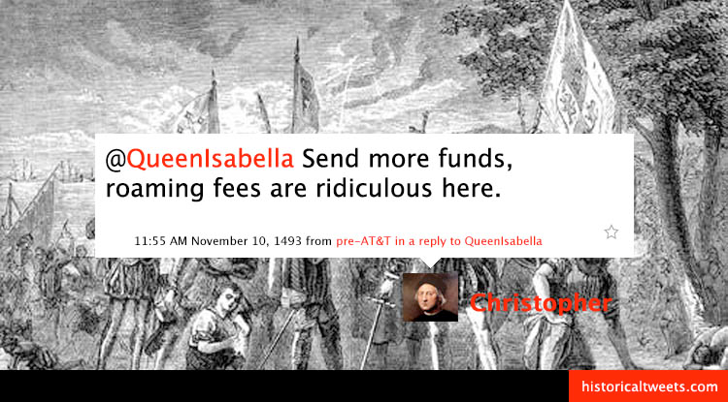
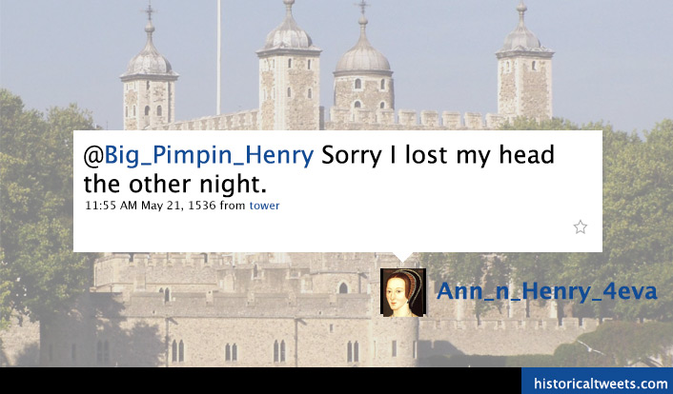
CLIL AND SOCIAL NETWORKING
Social networking websites usually lay down detailed rules for their users that also affect the choices of language. Twitter, particularly, limits tweet length to 140 characters so that users tend to adopt abbreviations, clippings, contractions, blends, symbols and to omit spaces between words. http://historicaltweets.com/

Slide 7
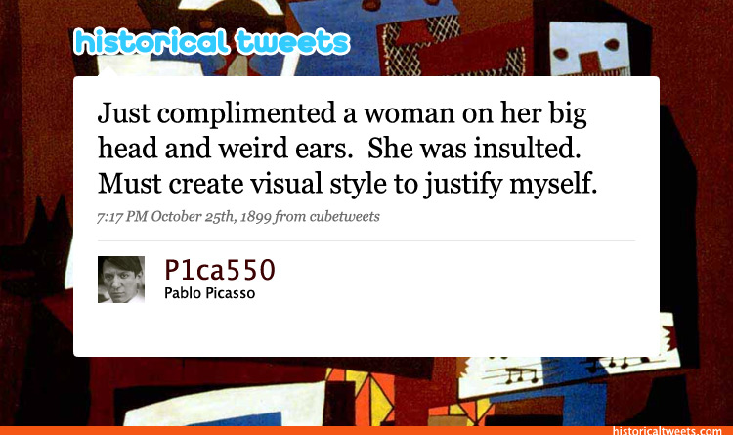

Slide 8
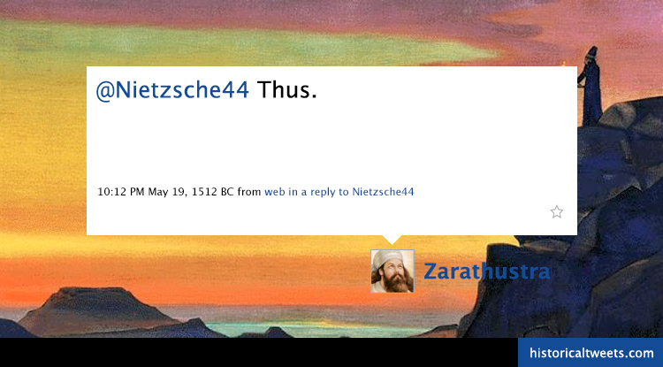

Slide 9
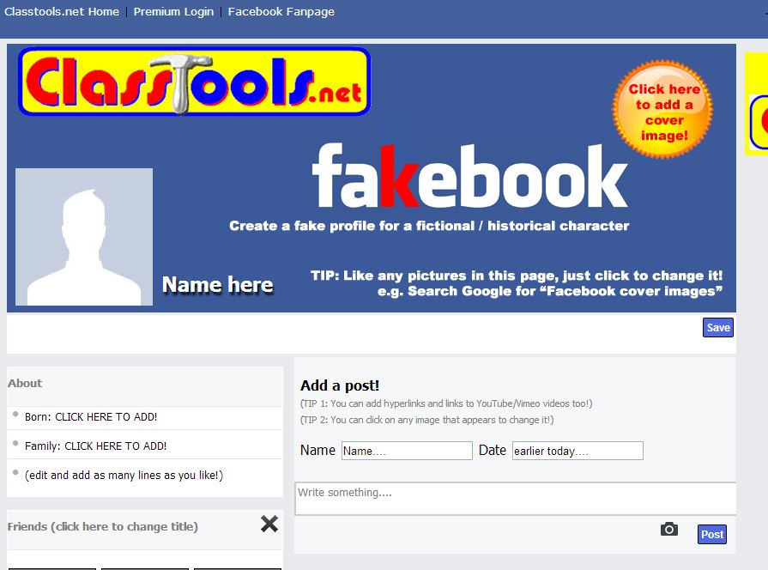

Slide 10
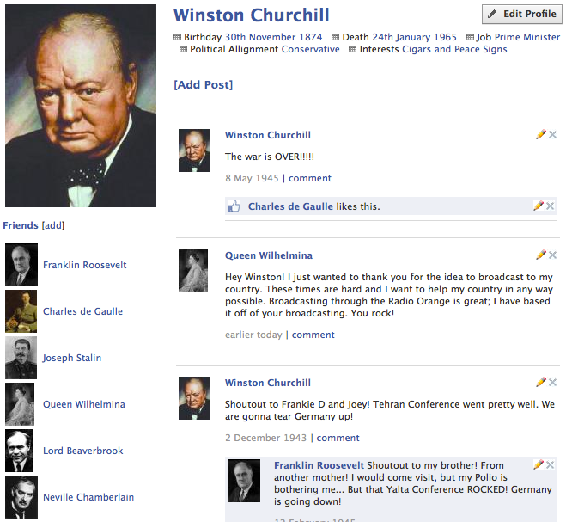

Slide 11
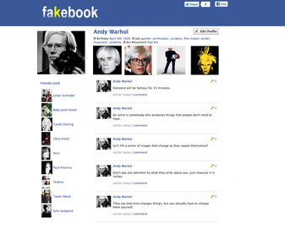
Example of fakebook exercise
Directions to give to the students:
1. Choose the event or person/character you would like to use on your fakebook page. (philosopher, political scientist, artist painter architect)
2. Use the Internet to research facts that can be included on the page. For example: date of birth, city/state they reside in, friends, etc.
3. Locate photos/images using the Internet that could be included on your fakebook page. Save the photos to your home folder. Be creative!
4. Now, you are ready to use the templates to design your fakebook page.

Slide 12
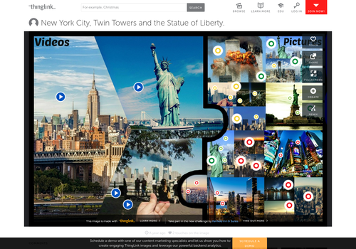
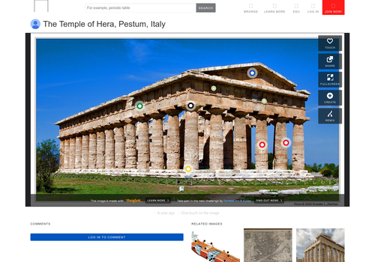
TALKING IMAGES an interesting tool for engaging students in CLIL
https://www.thinglink.com
THINGLINK is a free online application that allows you to store images and above all to turn them into interactive images. Your images can be connected through internal links to textual content, music, videos or texts. Users can create hot spots on specific parts of an image by inserting some links to these resources, adding brief descriptions. The created images can be published in any website using the embed code, shared by the major social networks or email.
Why do not invite students to create talking images on their own? Perhaps as a final outcome of a CLIL unit, to summarize the concepts learned, to improve the use of correct terminology .... Or also to create easy speaking glossaries. Or mind maps .... Just have fun, let ideas run...

Slide 13

GLOGSTER
During this term my students have been studying and practising descriptions and lexicon related to FOOD SECURITY . Recent project this has consisted in designing and creating a presentation (individually) related to the topic by means of GLOGSTER: Glogster is a social network website and the big thing you can do with it is making Glogs. Glogs are basically interactive posters that you can make and share. Using Glogster is very easy when making presentations, journals, and so on visually attractive.

Slide 14
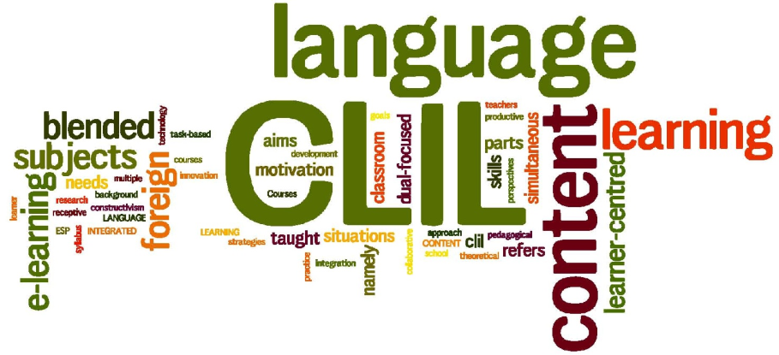
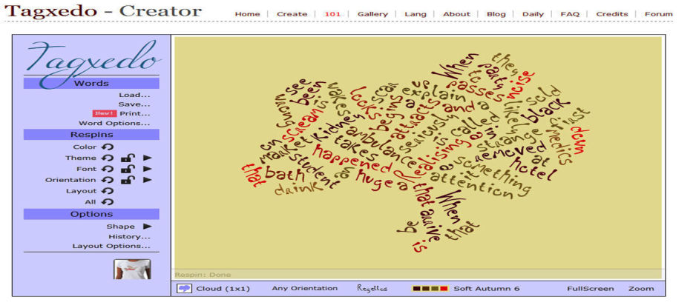
GUESSING THE LESSON. Word clouds creators
ICE BREAKER TECNIQUE: Tag clouds brain storming activity
Use free word cloud generating software such as
www.wordle.net, http://www.wordclouds.com/, https://www.jasondavies.com/wordcloud/#%2F%2Fwww.jasondavies.com%2Fwordcloud%2Fabout%2F , http://tagcrowd.com/ or other to create a word cloud from a text. Project this into a digital whiteboard and ask learners to guess the topic of the lesson (warm up activity). Word clouds graphically feature vocabulary items on the grounds of their frequency; thus, words that occur more often in a text are featured with a bigger font size. As a result, the distribution of content-specific lexical items in a text affects the dimension of the words in the word clouds, which makes statistically based data visually accessible to users at a glance. Texts can be pasted directly in the Word cloud generating
box; the web-based tool itself counts word frequency. Colours, fonts, and layouts can be tweaked, which makes word clouds more motivating for learners.

Slide 15
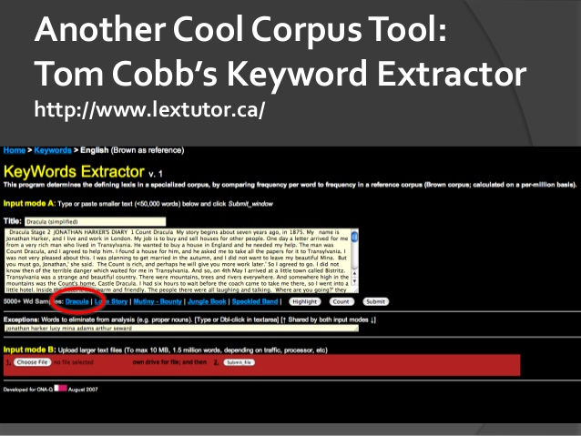
Keyword Extractor Tool
http://www.lextutor.ca/key/

Slide 16
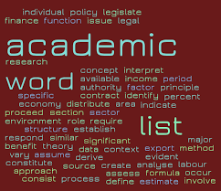


THE ACADEMIC WORD LIST (AWL)
To firstly familiarize and afterwards enable teachers to identify the key academic vocabulary targeted in their CLIL lessons autonomously, you can use the EAP Foundation AWL (Academic Word List): http://www.eapfoundation.com/vocab/academic/awllists/
Or the University of Nottingham AWL: http://www.nottingham.ac.uk/alzsh3/acvocab/index.htm
The academic word lists enable teachers to plan language objectives in terms of academic language and thus gradually build learners’ academic vocabulary competences.

Slide 17


Let’s puzzle! Tools for LANGUAGE GAMES’ creating
http://www.puzzle-maker.com/
http://www.discoveryeducation.com//free-puzzlemaker/index.cfm?campaign=flyout_teachers_puzzle
Vocabulary revision strategy .
Use crosswords to review vocabulary for your Clil lessons. Students might actually enjoy doing the assignment! Crossword puzzles encourage logical thinking and correct spelling. Download the free program for making and storing crossword puzzles at:
http://www.eclipsecrossword.com

Slide 18
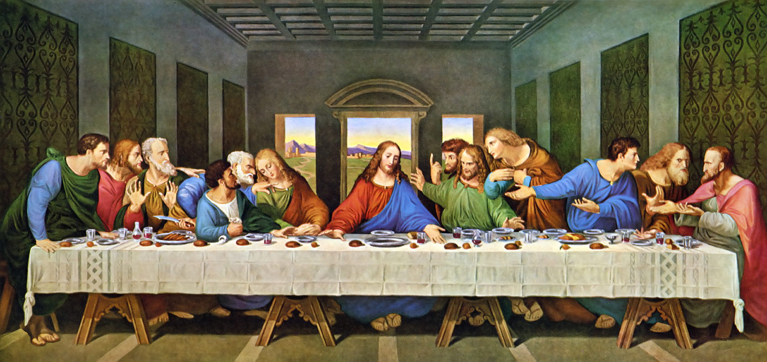

WHAT COULD BE BEING SAID HERE?
Use one or more of the speech bubbles for a conversation

Slide 19
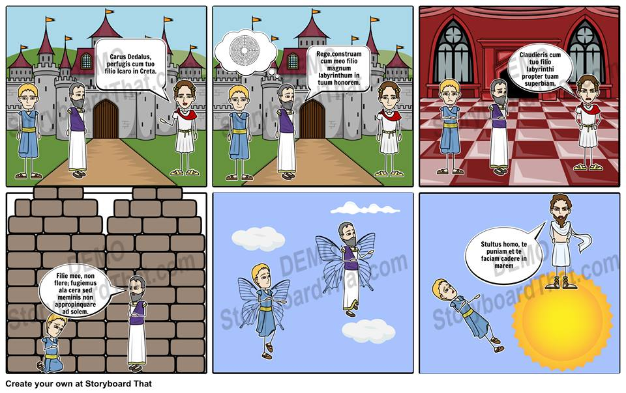
DIGITAL STORY TELLING
STORYBORD THAT

Slide 20



Let’s play. Review games
https://www.studystack.com Explore the sets of flashcards. Find a set you could give learners according to the topic you teach in clil approach. Copy the links and put them into your wiki. Sign in and create your own vocabulary exercises.
Software to create exercises are usually freely downloadable and programmed with user friendly interfaces, very intuitive and easy to use (for example Hot Potatoes http://hotpot.uvic.ca/)

Slide 21
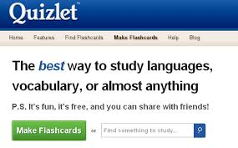
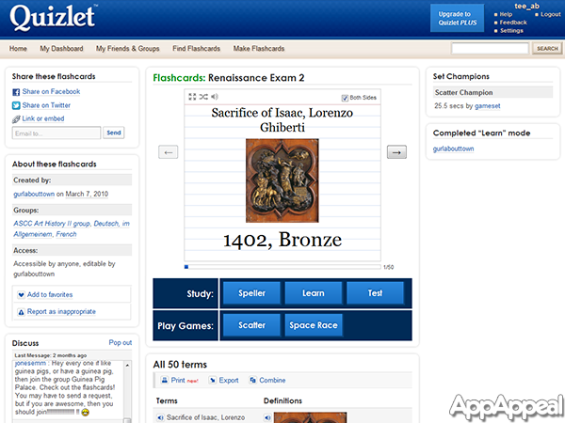
QUIZLET
Explore http://quizlet.com and create a set of vocabulary items for learners to practice. By Quizlet you can create tests of various types with pictures included. You can use flashcards that have been already made by other users who have decided to share their tests. But not only that: you can also customize tests created by other users.

Slide 22
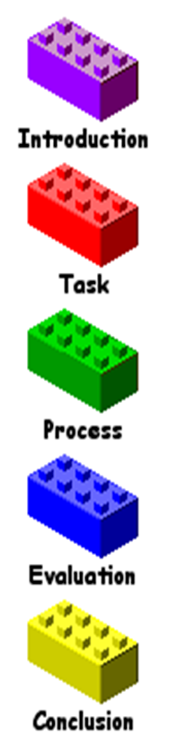
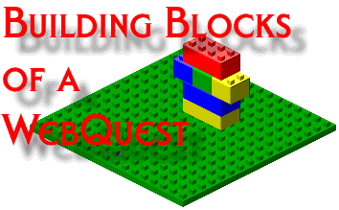

Task based approach on the Web
Use Web 2.0 for collaborative tasks . Project-based learning (PBL)
E-literacy skills can be developed through internet-based projects and activities. One activity is a WebQuest (see http://webquest.org/).
A WebQuest is an inquiry-oriented activity in which some or all of the information that learners interact with comes from resources on the Internet. (Dodge, 1995:1)
Web quest is built around an engaging and doable task that elicits higher order thinking of some kind. It's about doing something with information. The thinking can be creative or critical, and involve problem solving, judgement, analysis, or synthesis. The task has to be more than simply answering questions (Starr, 2000)

Slide 23
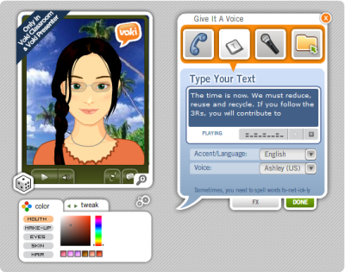
VOKI
Voki allows you, or your students, to generate fun listening activities through the creation of avatars to represent you, a fictitious character, or your students. You can use TTS, upload audio files or use your smart phone to record. You can place your listening activity (avatar) in your social network site or blog, or even email it for homework. Voki can be used for the post-listening stage. You may decide, for example, to have your learners create their own Voki as a response. The advantage of using TTS technology is that if students have memorized words with the wrong pronunciation, once their text is converted to speech, they will notice the difference. After all, research shows that learners have consistently reported that memorizing words with the wrong pronunciation greatly interferes with their listening comprehension performance (Goh, 2008).

Slide 24


LISTENING
Go to http://www.lessonstream.org and find a video clip you like and can use with your learners. Download the clip and the lesson plan that goes with it.

Slide 25


Not only Power Point …
PREZI:
My CLIL dissertation
https://prezi.com/ej0ddkwlcefj/copy-of-the-slavery-un-percorso-didattico-modulare-di-storia-in-metodologia-clil/
PowToon.
https://www.powtoon.com

Slide 26
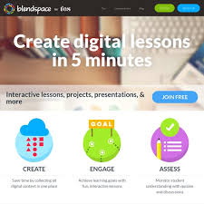
CREATE YOUR OWN LESSON https://www.tes.com/lessons

Slide 27


